Slide 1
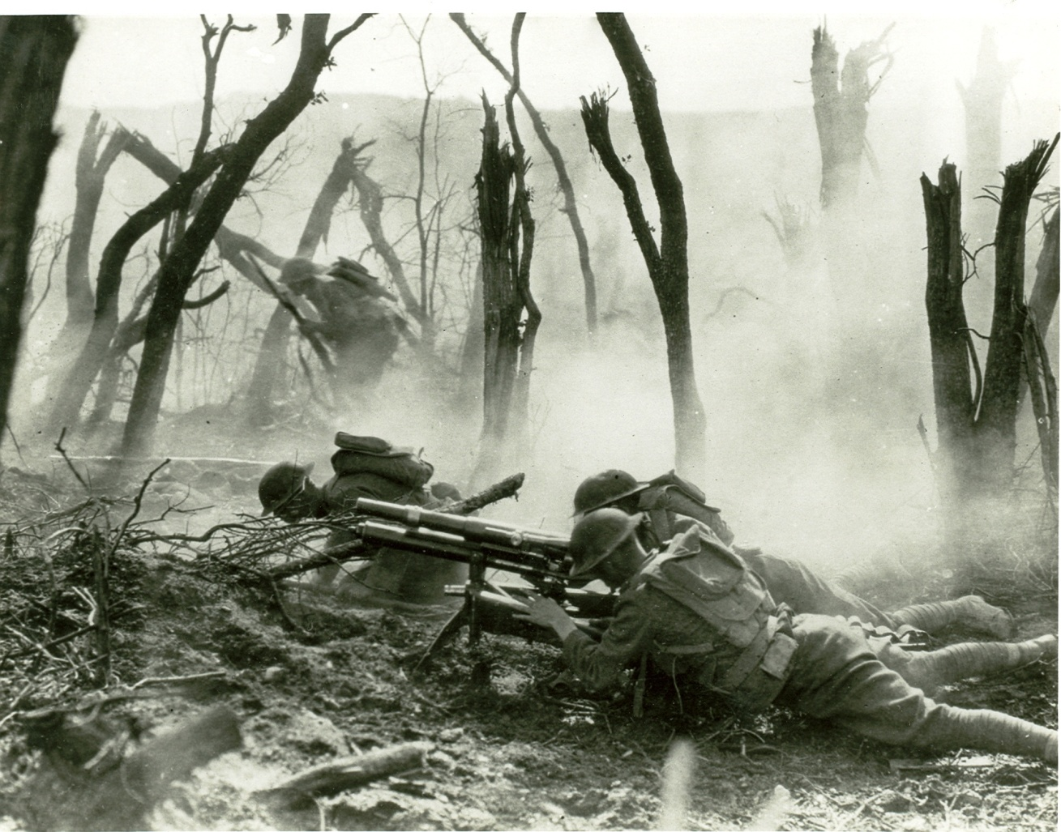
WWI: How it Started
“the war to end all wars”

Slide 2
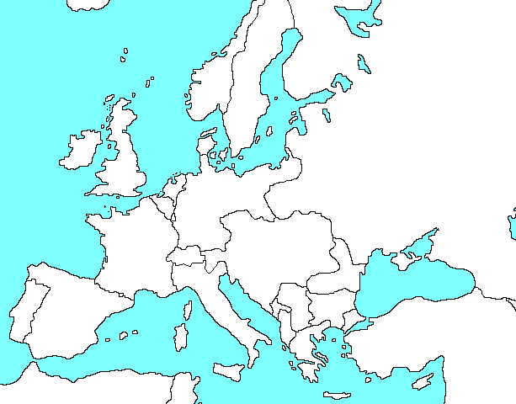
Europe 1914

Slide 3
FOUR Key Causes:
-Imperialism
-Militarism
-Nationalism
-System of Alliances

Slide 4
Imperialism
The Empires of Europe had spent centuries fighting one another for territorial control over the various parts of the earth.
The desire for control led to a CONSTANT competition among them for supremacy.

Slide 5
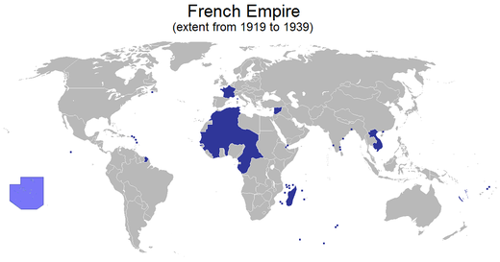

Slide 6
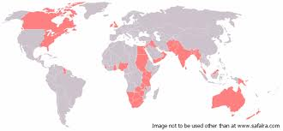
British Empire

Slide 7
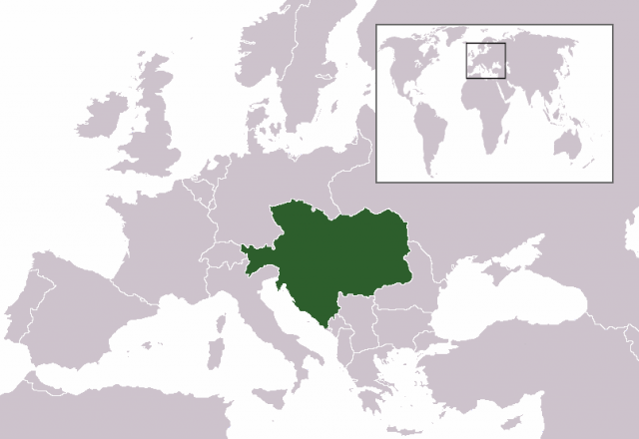
Austro Hungarian Empire

Slide 8
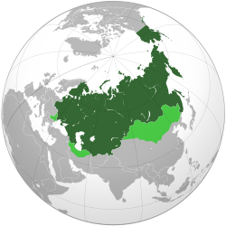
Russian Empire Map

Slide 9
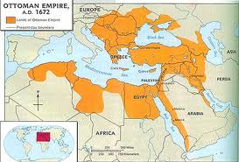
Ottoman Empire

Slide 10
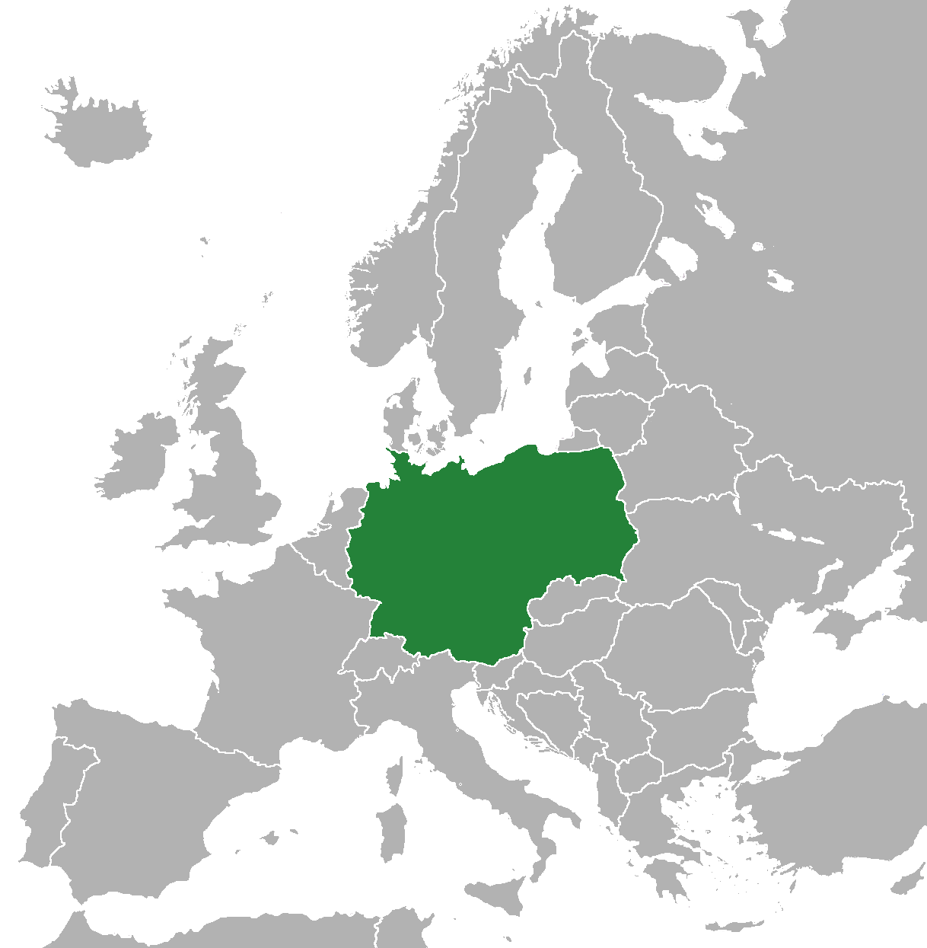
Prussian (German) Empire

Slide 11
Militarism
In order to effectively compete, empires of course needed the latest and greatest military technology, the greatest number of troops, ships, fortresses, guns… you name it.
Building up your military was part of the competition among the European Empires

Slide 12
Nationalism
Of course, any good fight or competition needs a good cause… love of country and loyalty is as good as any.
Extreme nationalism, especially between France and Germany, fueled much of the conflict to come.

Slide 13
System of Alliances
The system of alliances, at the time, was seen as a kind of insurance policy against being ganged up on. If others knew that you had other powerful friends in your corner, then no one would ever mess with you… that backfired badly.
Just as two rival street gangs never back down or give up their position, the two sides of the alliance system, the Allied powers and Axis powers each refused to be reasonable… too much honor at stake (remember Nationalism).

Slide 14
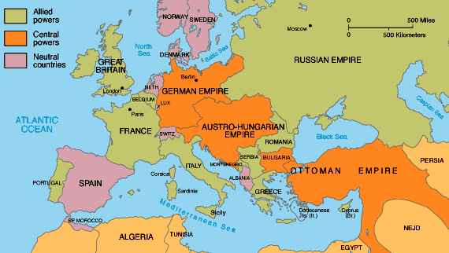
Axis and Allied Powers

Slide 15
Austria-Hungary’s Plan to take Serbia
Archduke Franz Ferdinand: A-H nobility sent to Serbia along with military parade for the purpose of swaying the Serbian public toward joining the empire

Slide 16
Archduke Franz Ferdinand

Slide 17
The Black Hand
Serbian independence/ liberation organization… the A-H empire referred to them as a terrorist group.
It was this organization that planned the assassination of Archduke Ferdinand and trained a number of assassins including Gavrillo Princip

Slide 18
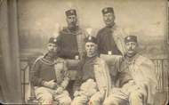

Slide 19
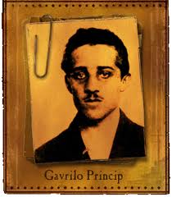
Gavrillo Princip
Young assassin who committed the murder of Archduke Ferdinand and his wife while on parade in Serbia’s capital, Sarajevo.

Slide 20
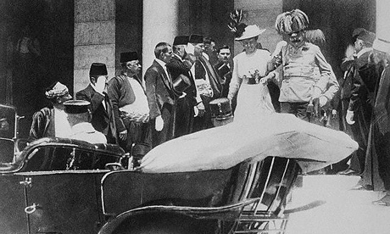

Slide 23
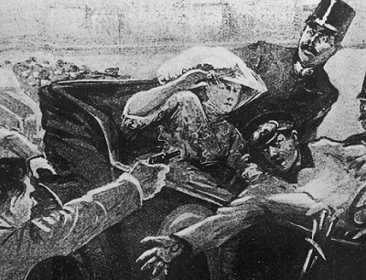

Slide 24
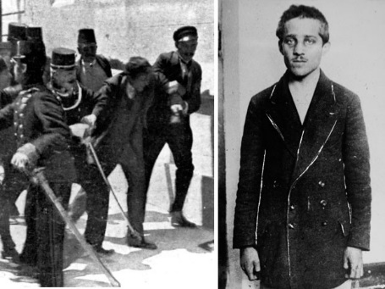

Slide 25
How Ferdinand’s Assassination Started a World War:
The System of Alliances is the key to understanding:
Russians and Serbians are ethnic “cousins”… Russia feels honor-bound to defend their “own people”
Russia declares war on A-H. A-H and their ally, Germany begin preparations.
Germany, bound by their alliance with A-H, declare war on Russia AND France (Schlieffen Plan)
Britain, allied with France and Russia declare war on the Axis Powers
… the “Great War” as it became known, had begun.

Slide 26
Schlieffen Plan
Germany’s Plan to avoid fighting a two-front war.
The idea was to wipe out France as quickly as possible before Russia had a chance to mobilize and attack Germany’s Eastern Front.
It ALMOST worked! …the war and the world would have turned out VERY differently if it had.

Slide 27
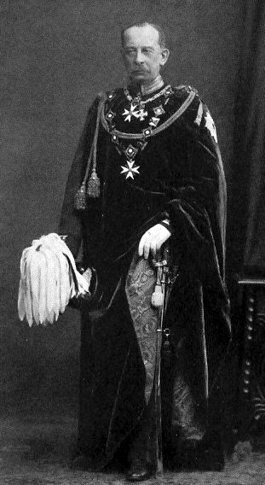
Alfred Graf von Schlieffen

Slide 28
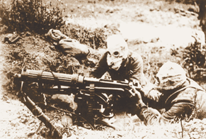
WWI

Slide 29
The Empires Prepare for War:
No one seemed to recognize that this war would not be like any other in the past…
New technologies combined with industrial-scale mass production were only just being developed at the start of the conflict, but would soon change the nature of the war in terrible ways.
When the call for recruits went out in each empire, hundreds of thousands of young men eagerly volunteered to served their King and prove their honor and bravery

Slide 30
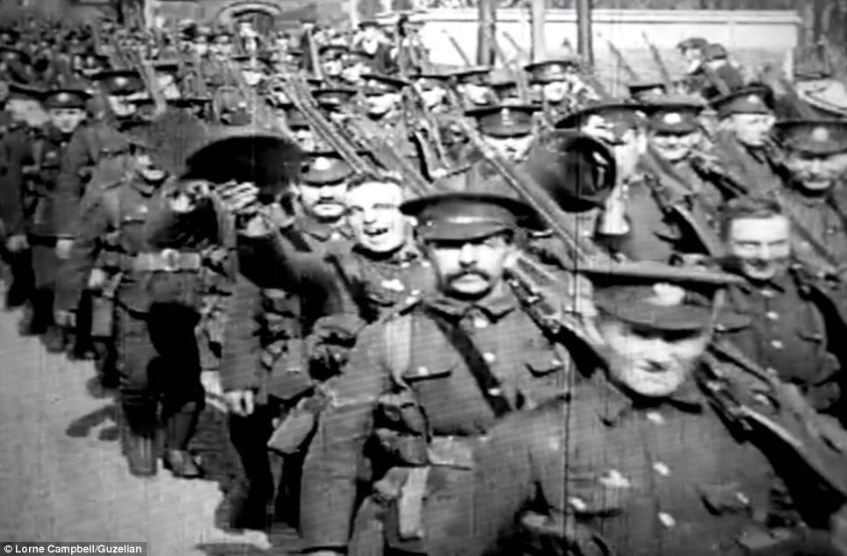
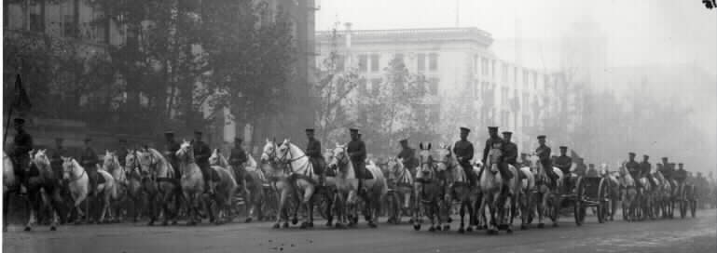

Slide 31
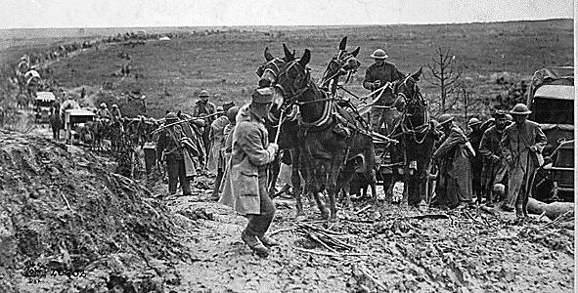

Slide 34
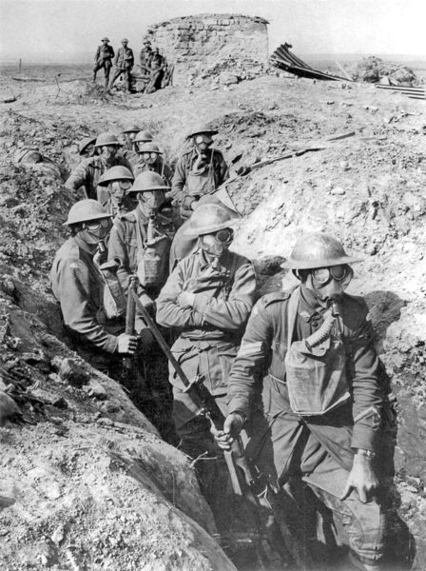
Trench Warfare
A new form of warfare,
Trench warfare was
necessary due to deadly
new weapons such as:
*high explosives
*airplanes
*tanks
*machine guns
*chemical poisons
*mass production
...and many others

Slide 35
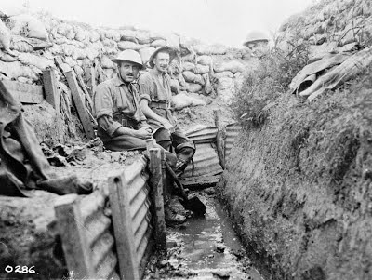
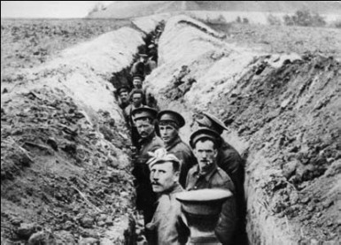

Slide 36
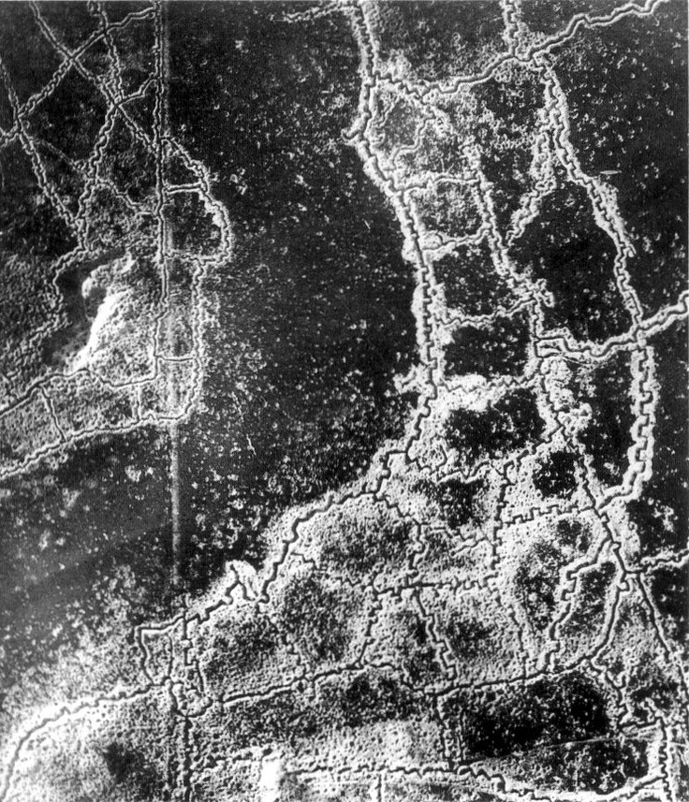

Slide 37
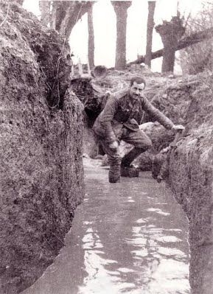
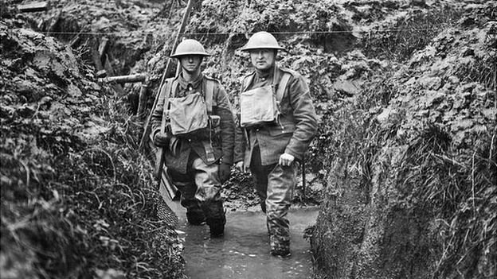
A trench was little more than a ditch to hide in, out of range of enemy fire. But, like any other ditch, they fill with rainwater… and with thousands of men living in them, they quickly become an inescapable open sewer. This reality creates a problem never before seen in human history:

Slide 38
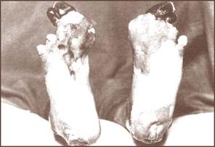
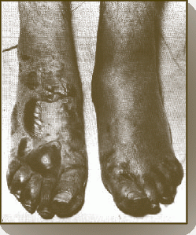
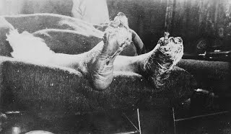
“Trench Foot”

Slide 39
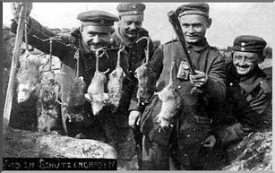

Slide 40
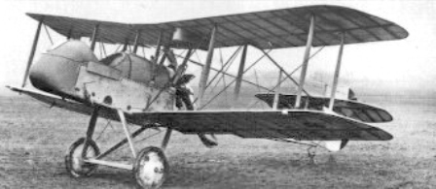
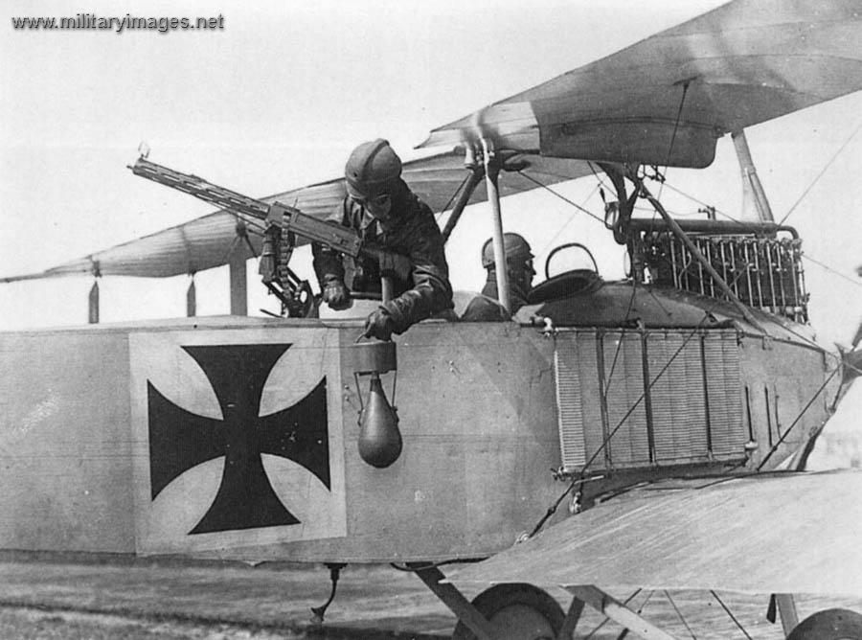
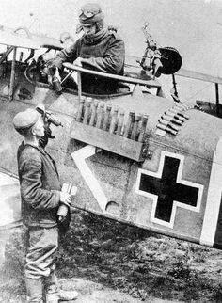

Slide 41
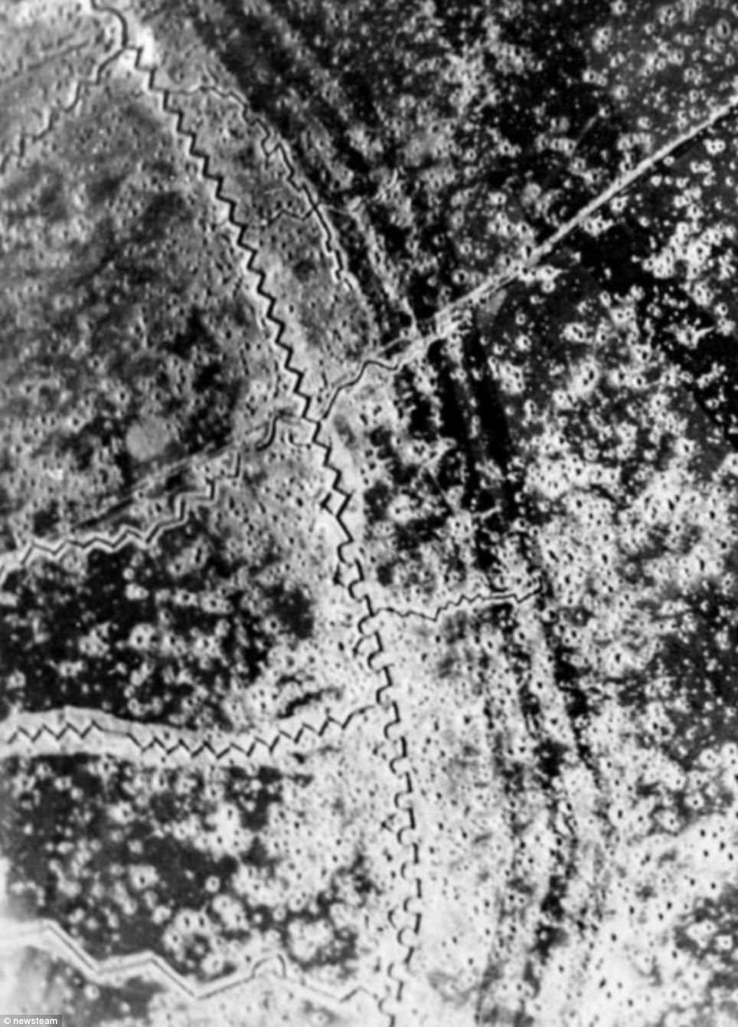

Slide 42
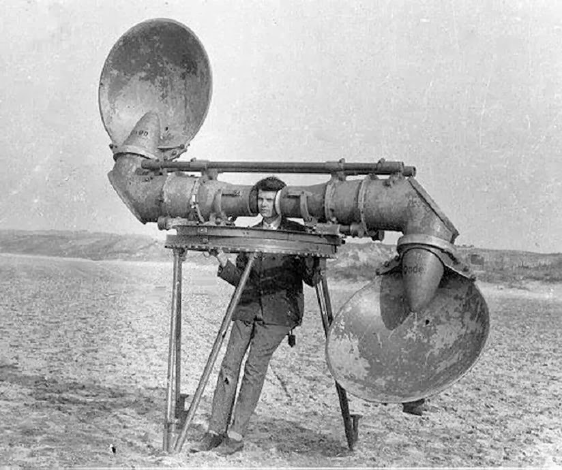
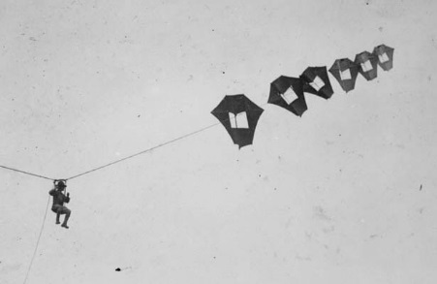
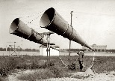
Air raid detection before Radar

Slide 43
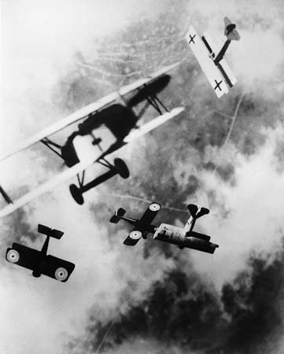
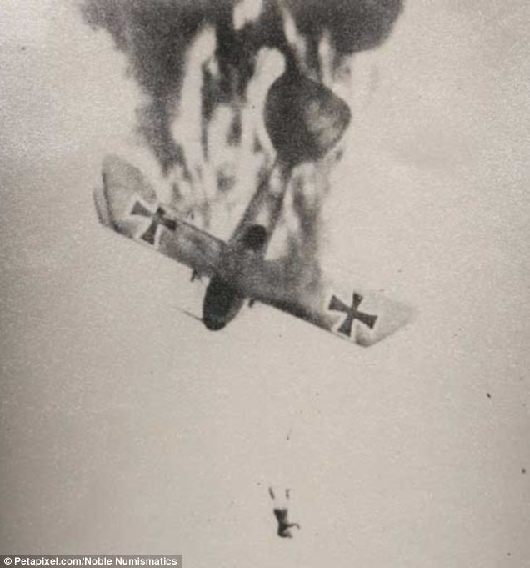
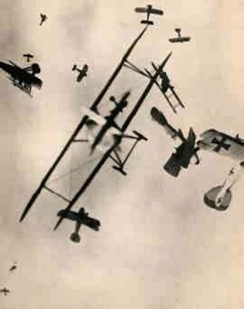
“dogfights” (air combat)

Slide 44
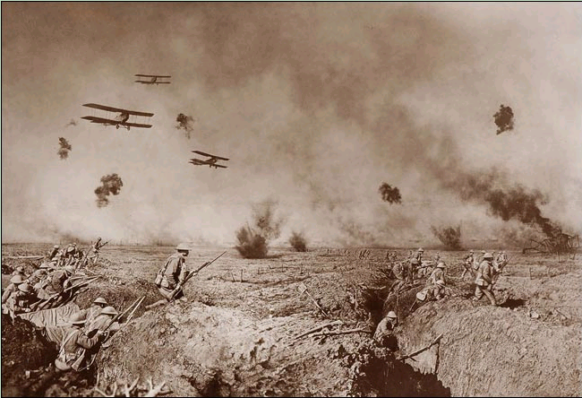

Slide 46
Going “Over the Top” …near-certain death

Slide 49
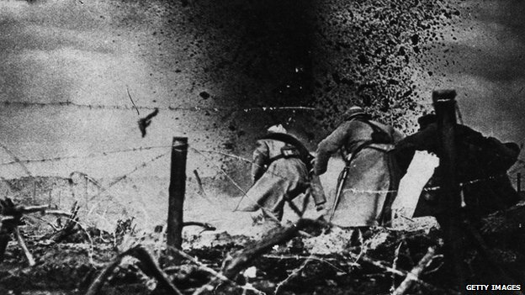
“No Man’s Land”

Slide 52
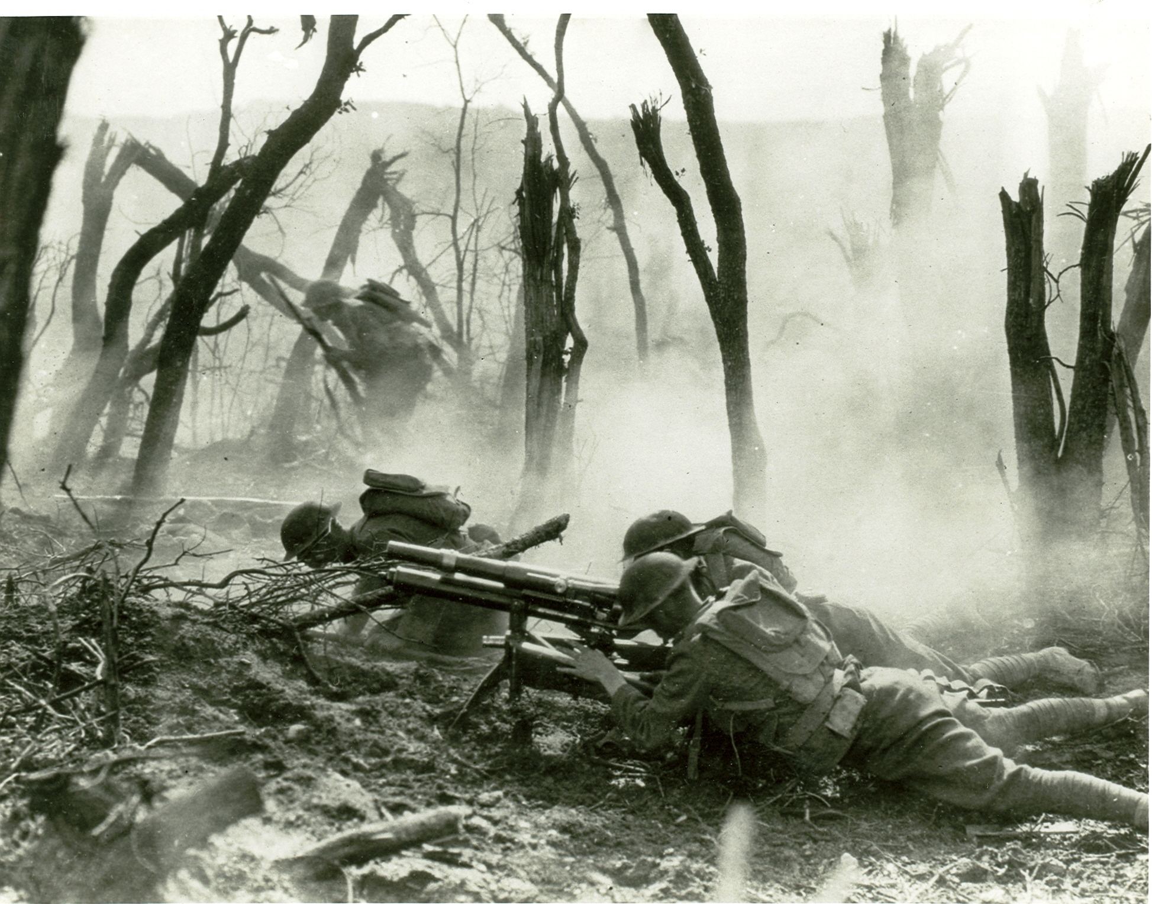

Slide 53
