Slide 1
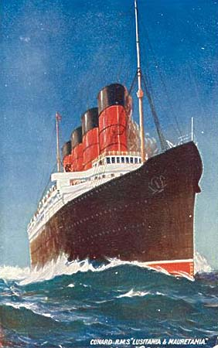
US Enters the War
Why and How

Slide 2
American Neutrality
From the outset of this European conflict, Americans viewed it as just that, a EUROPEAN problem and saw no reason for involvement.
The Wilson administration clearly stated its position of Neutrality.
The US would trade with ALL European Empires EQUALLY ;)

Slide 3
The 1916 Election
Wilson will win reelection because of his strong neutrality stance. His campaign slogan was “He Kept Us Out of War”!

Slide 4
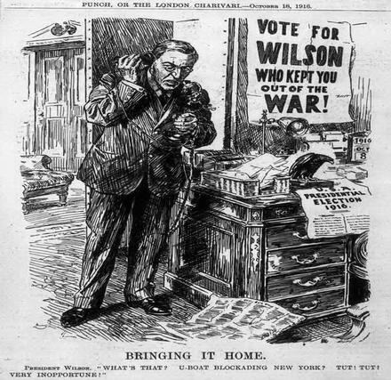

Slide 5
The Preparedness Movement
Not all Americans felt that the US could remain neutral, for several reasons:
If our allies in Europe lose, it would be very bad for the US politically.
If the war threatens our ability to trade with European or other world markets.
If democratic institutions are threatened, we might be the only force who could save them.
For these and other reasons, Americans with these concerns formed the Preparedness Movement. They wanted the US to invest in Military Equipment and train a standing army to have ready should it become necessary for the US to become involved.

Slide 6
The National Security League
To promote their views, the Preparedness movement created the “National Security League”, designed to “inform” and involve Americans. The information spread by the League was almost entirely fear-mongering propaganda… so it was pretty effective.
When America eventually did enter the war, the League gained a level of legitimacy and authority… membership was a way of showing support for the war effort.

Slide 8
The Peace Movement
Consisting mainly of former Populists, progressives, and Social reformers… lots of women too.
To their mind, there was no good argument for involvement in the European conflict.
Their response to the Preparedness Movement was that if they wanted to prepare for war, there should be a special tax on the Arms manufacturers to pay for it, rather than taxing the public.

Slide 9
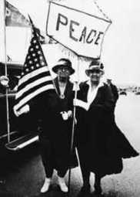
The American Union Against Militarism
Like the Preparedness Movement, the Peace Movement had its own activist organization to promote its views… the “American Union Against Militarism” The organization was popular among Progressives, Populists, and Women’s organizations.

Slide 12
Pressures to End Neutrality:
German U-Boat attacks on merchant ships
The Lusitania (Sussex Pledge)
US Business interests (foreign debt and trade)
Russia exits the war (Bolshevik Revolution)
The Zimmerman Telegram

Slide 13
German U-Boats:
German attacks on merchant and passenger ships upsets American foreign trade… threatening American business… fueling the Preparedness Movement… pushing US from its neutral position.

Slide 14
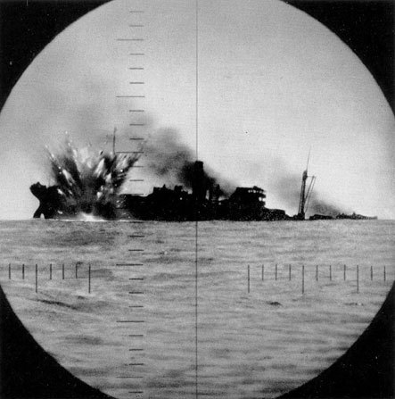
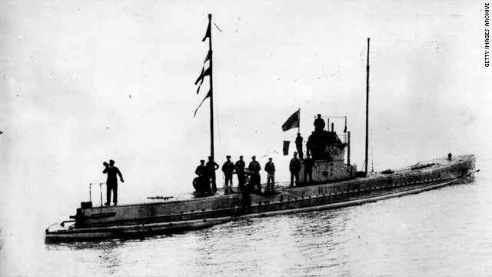

Slide 15
The Sinking of the Lusitania
The Lusitania was a British Luxury liner refitted for the war effort. It was turned into a hospital ship to ferry wounded soldiers across the English channel.
The attack on the Lusitania was highly publicized. 128 Americans were killed when the Lusitania was struck by German torpedoes… pushed the American PUBLIC closer to war.

Slide 16
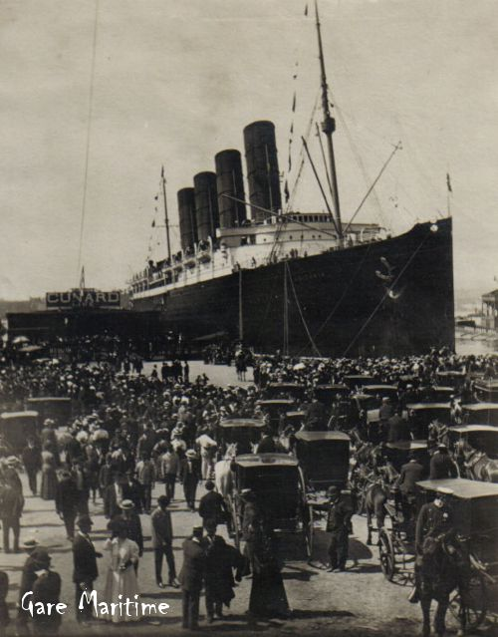

Slide 20
US Business Interests
American industries were PROFITTING from the war. We sold products to ALL sides of the war in greater quantities than ever before… the needed stuff that they couldn’t produce themselves because they were too busy waging war.
Much of that profit was being lent to our allies… getting that investment back meant it was necessary to make sure our allies WON the war.

Slide 21
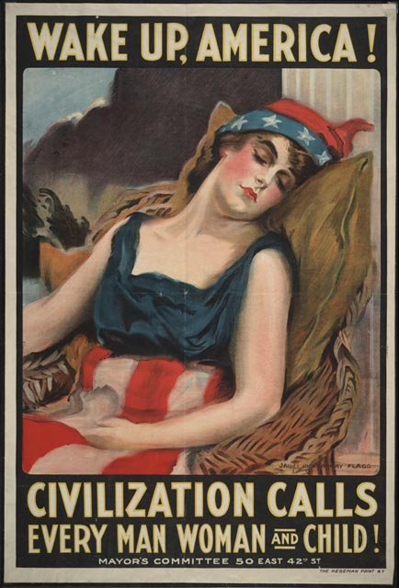

Slide 22
The Zimmerman Telegram
Sent from the German consulate intended for the MEXICAN government… WHY?
Promised Mexico would retrieve lands lost to the US in the Mexican-American war if they would help Germany in a future attack on the US.
Intercepted by the Brits and publicized in the US… MAJOR push toward war with Germany.

Slide 24
Russia Exits the War in 1917
Long-standing political, social, and economic issues in Russia, combined with the strain of the war, pushed Russia into a VERY transformative revolution… as a result, Russia exited the war effort.
Russia leaving meant that Germany was no longer split between two battle fronts. They were able to focus their entire military on the French and British empires… they were WINNING!
Lets look at the Russian Revolution now...

Slide 25
The Sinking of the City of Memphis and the Vigilancia
Between March 16 and 18th the German navy, despite signing the Sussex Pledge, torpedoed and sank two US ships… that was the last straw for President Wilson.
A war resolution was passed through Congress and signed by the president on April 6, 1917. War with Germany was declared.

Slide 27
Preparing for War
Selective Service Act
American Expeditionary Force
Training
Doughboys
Convoy System

Slide 28
Selective Service Act
Going to war meant building an ARMY. Our standing army at that time was comparatively small compared to today.
Congress passed the Selective Service Act authorizing a DRAFT of young men for military service. 24 Million registered, 3 million drawn in a lottery for service

Slide 31
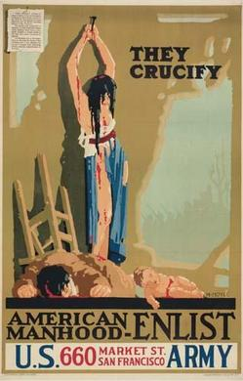

Slide 32
American Expeditionary Force
The AEF was made up of volunteers for the war effort (today’s National Guard)
As many as 25 thousand of these were women who served a wide variety of non-combat roles important to the war effort.

Slide 33
Training for War
Training camps were set up all over the country.
Draftees and volunteers were trained how to use their equipment: bayonets, gas masks, grenades, and learn tactics of warfare.
British officers were sent over to teach about trench warfare.

Slide 34
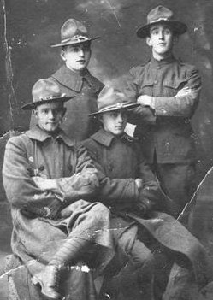
Doughboys

Slide 35
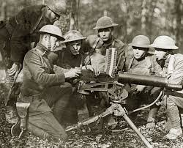
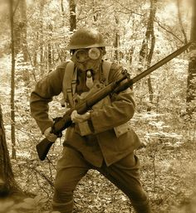

Slide 37
Convoy System

Slide 39
