Slide 1
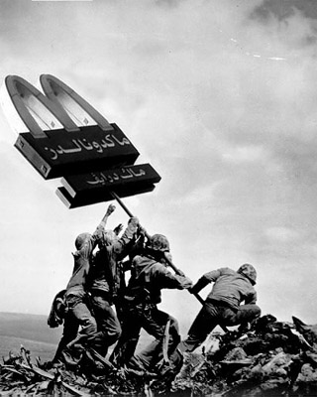
US Becomes a World Power

Slide 2
Objective:
To understand how the United States moved into the role of a world power and to recognize the long-lasting effects of that shift.
What makes a nation a “world power”?

Slide 3
Colonization vs Imperialism What’s the difference?
Colonialism is where one nation takes control over some other territory.
The “colonial era”, generally, begins with Columbus and fades out after WWII.
Imperialism refers to the control itself… political or economic control, either formally or informally.
The “Age of Imperialism”, for the US, begins soon after the Civil War and ends with WWI.
I TAKE (colonize) to CONTROL (imperialize).

Slide 4
Why might a newly formed US struggle with the decision to take new territory?
Our founding values were centered on liberty and freedom for common men. If we say we are for freedom, how can we, in good conscience, take freedom from others?
… so, how did we justify seizing territory beyond our original 13 colonies?

Slide 5
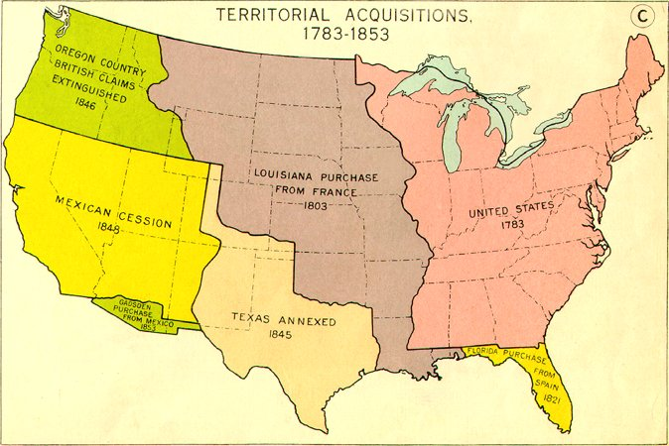
Manifest DESTINY… Solves the Moral Dilemma It isn’t taking if its supposed to belong to you anyway!

Slide 6
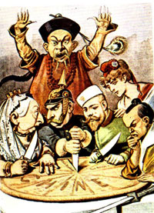
Anti-Imperial Sentiment
Not Everybody wanted an Empire:
At first, most Americans had little interest in territorial expansion:
Imperial rule seemed inconsistent with America's republican principles. (Even with Manifest Destiny)
The US did not welcome people with different cultures, languages, and religions.

Slide 7
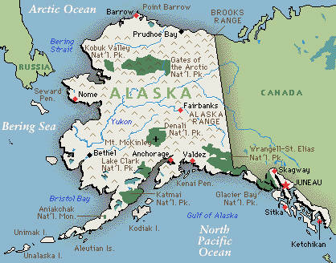
Acquisition of Alaska
The exception to the rule was Alaska. In 1867, Sec. of State William Seward arranged to buy Alaska from the Russians for $7.2 million. Rich in natural resources (timber, minerals, and oil), Alaska was a bargain at two cents per acre.

Slide 8
“Closing” of the Western Frontier
In the late 1800s the US Census Bureau declared the western frontier “closed” i.e. sufficiently tamed and populated.
Many feared that the nation would begin to stagnate if we stopped growing and expanding, believing that expansion is what had given our nation its spirit, strength, and vitality.

Slide 9
Factors Influencing US Imperialism
Economic Growth
Fear of Competition
Dependency on Foreign Trade
American Security
Growing European Imperialism
Desire for Sea Power

Slide 10
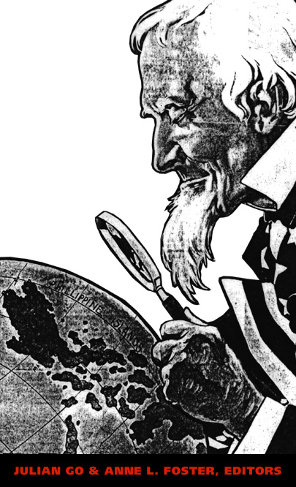
Fear of Competition
In the United States, a growing number of policy makers, bankers, manufacturers, and trade unions grew fearful that the country might be closed out in the struggle for global markets and raw materials.

Slide 11
Dependency on Foreign Trade
By the 1890s, the American economy was increasingly dependent on foreign trade. A quarter of the nation's farm products and half its petroleum were sold overseas.

Slide 12
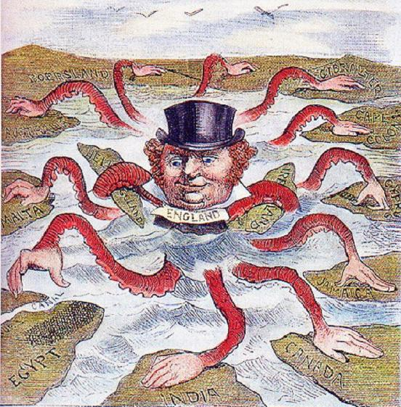
European Imperialism
By the mid-1890s, a shift had taken place in American attitudes toward expansion. Why? Between 1870 and 1900, the European powers seized 10 million square miles of territory in Africa and Asia. About 150 million people were subjected to colonial rule.

Slide 13
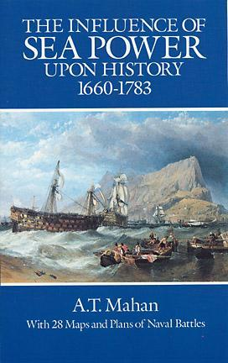
A Desire for Sea Power
Alfred Thayer Mahan, a naval strategist and the author of The Influence of Sea Power Upon History, argued that national prosperity and power depended on control of the world's sea-lanes. "Whoever rules the waves rules the world," Mahan wrote.
This man’s book and arguments changes the course of US foreign policy

Slide 14
The Great White Fleet
US Military spending was substantially increased under the Naval Act of 1890 which approved the construction of a great number of modern state-of-the-art steam-powered vessels.
The US Navy went from being one of the world’s weakest to strongest naval forces in less than a decade.

Slide 15
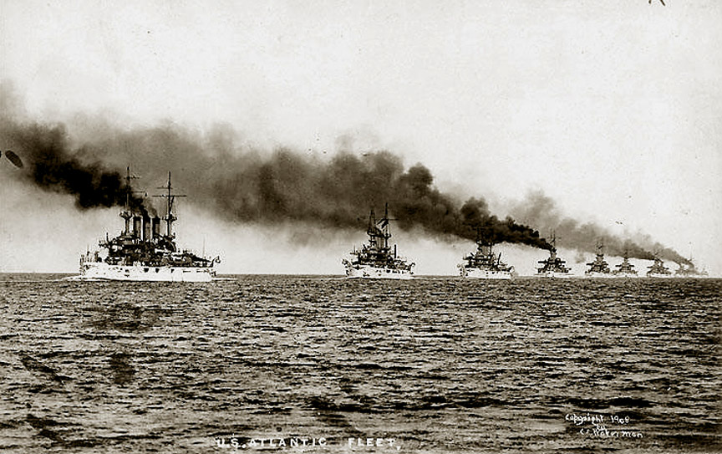

Slide 16
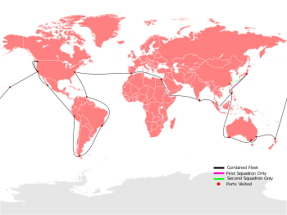

Slide 17
Broader Social Beliefs and Attitudes
Social Darwinism
“White Man’s Burdon”

Slide 18
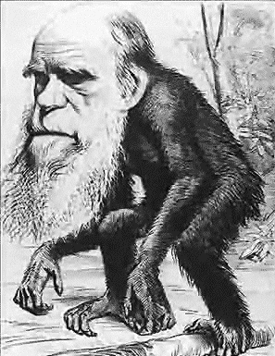
Belief in Darwinian Struggle
Social Darwinism: A belief that the world's nations were engaged in a Darwinian struggle for survival and that countries that failed to compete were doomed to decline also contributed to a new assertiveness on the part of the United States.

Slide 19
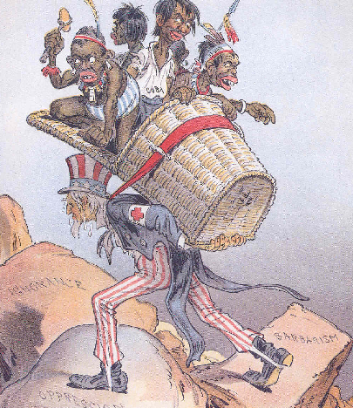
The White Man’s Burden
During the late 19th century, the idea that the United States had a special mission to uplift "backward" people around the world also commanded growing support.

Slide 20
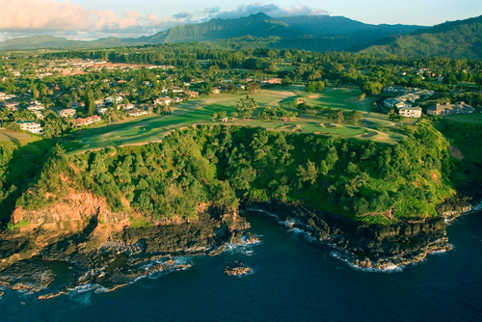
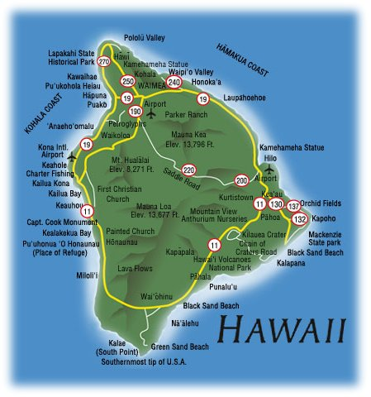
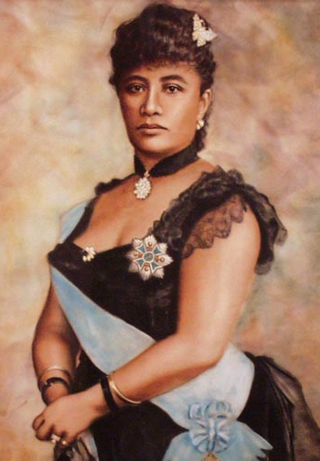
The Annexation of Hawaii
In 1893, a small group of sugar and pineapple-growing businessmen, backed by the U.S. military, deposed Hawaii's queen, seized 1.75 million acres of land, and conspired for U.S. annexation of the islands, which was achieved in 1898. Hawaii became a state in 1959.

Slide 21
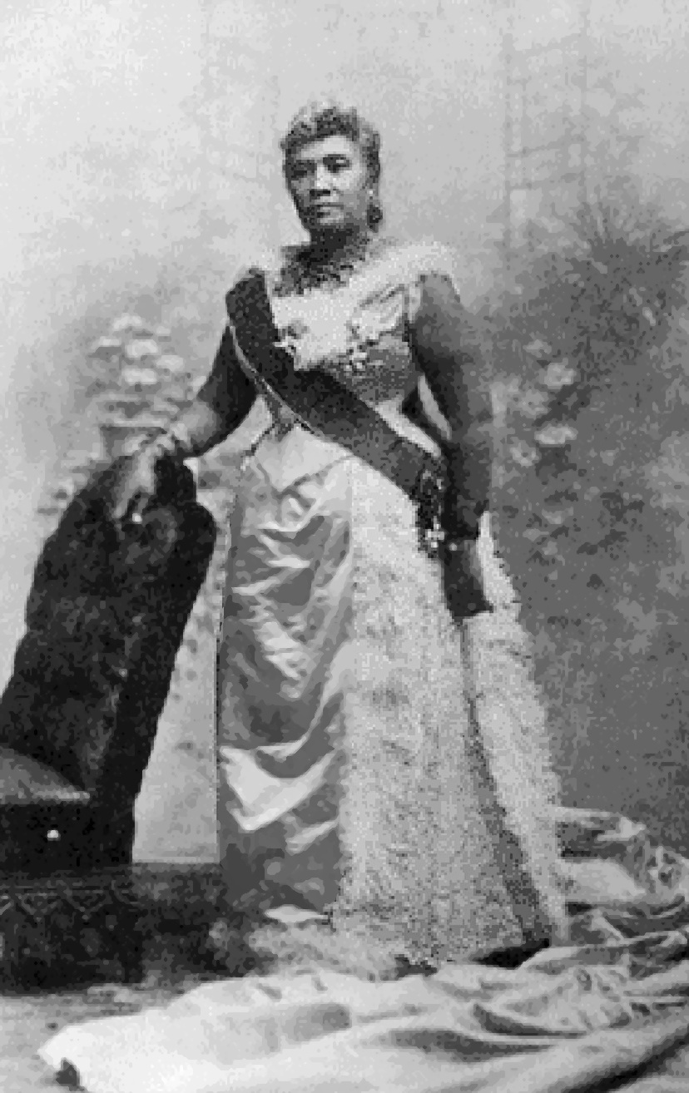
Queen Liliuokalani

Slide 22
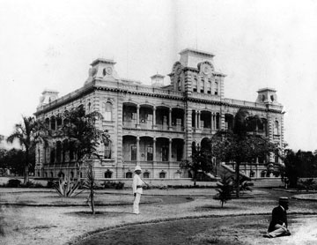

Slide 23
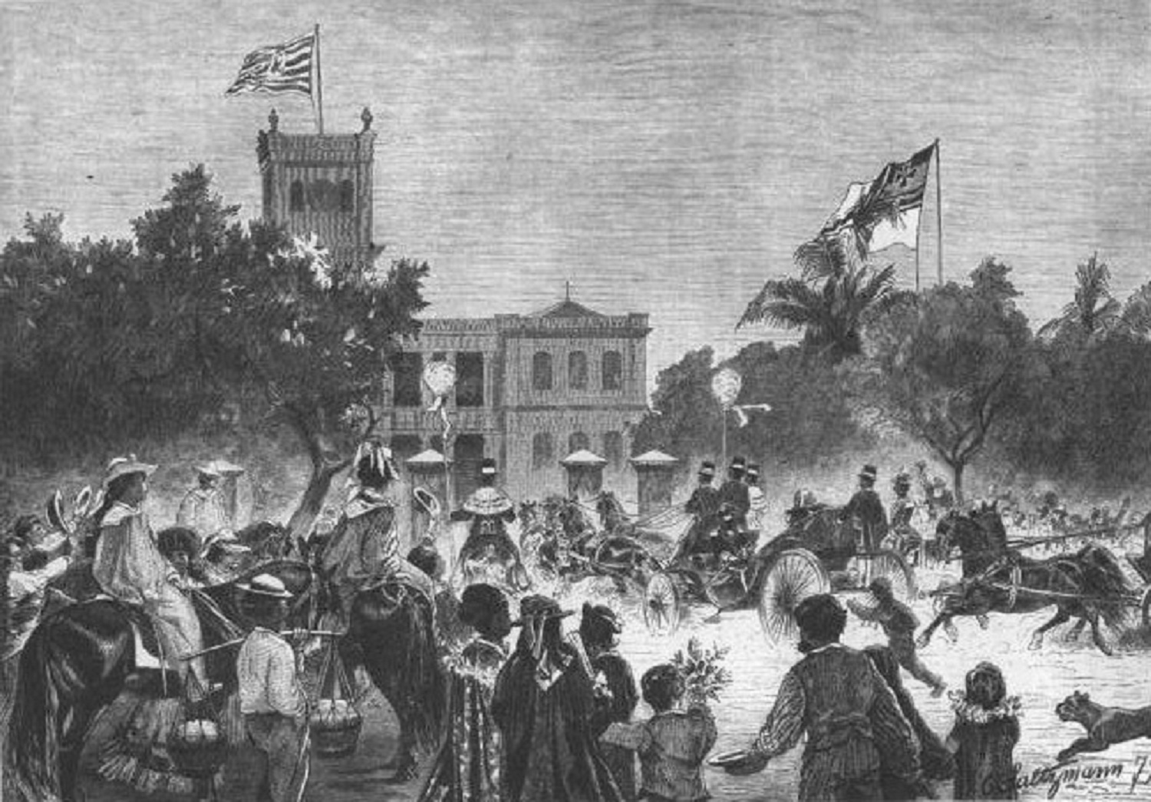
http://www.youtube.com/watch?v=XpsmUCtsd2o

Slide 24
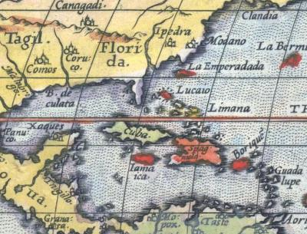
Origins of Spanish American War
The Tariff of 1894, which put restrictions on sugar imports to the United States, severely hurt the economy of Cuba which was then a Spanish colony. Angry nationalists began a revolt against the Spanish colonial regime.

Slide 25
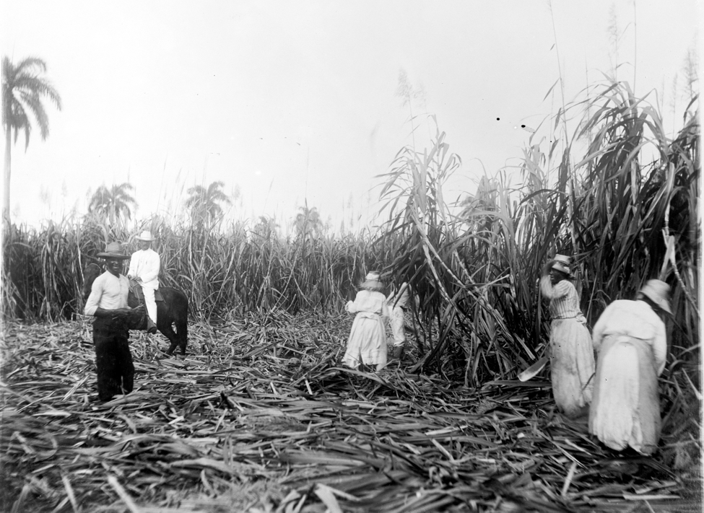

Slide 26
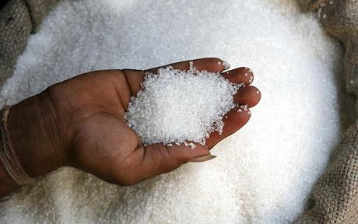
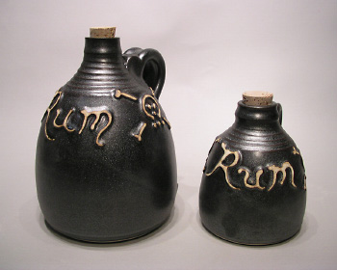

Slide 27
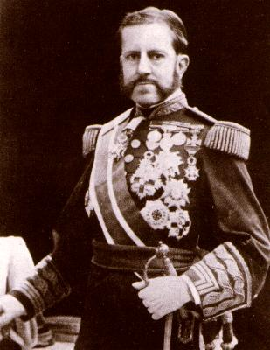
Valeriano Weyler

Slide 28
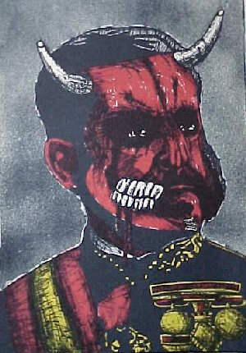

Slide 29
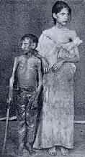
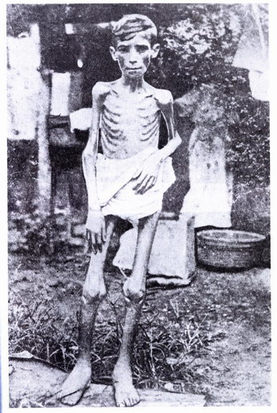

Slide 30
De Lome Letter
The De Lôme Letter, was written by Enrique Dupuy de Lôme, the Spanish Minister with the Portfolio of Cuba. In the personal letter, which was stolen despite being under diplomatic protection, he referred to the President William McKinley as "weak and catering to the rabble and, besides, a low politician who desires to leave a door open to himself and to stand well with the jingos of his party." On February 9, 1898, the letter was published in William Randolph Hearst's New York Journal.

Slide 31
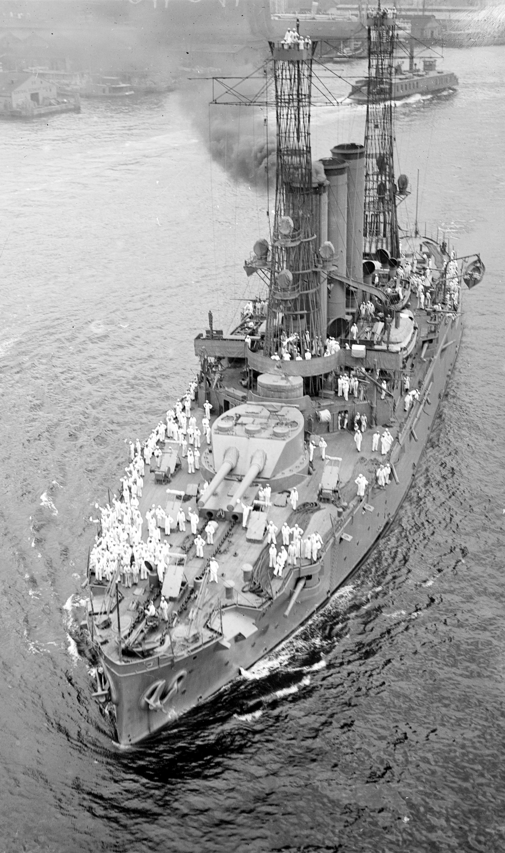
The USS Maine
The US, which had many businessmen with investment interests in Cuba, became concerned and dispatched the USS Maine to rescue US citizens who might be endangered by the conflict.

Slide 32
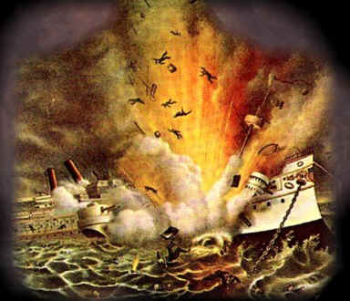

Slide 33
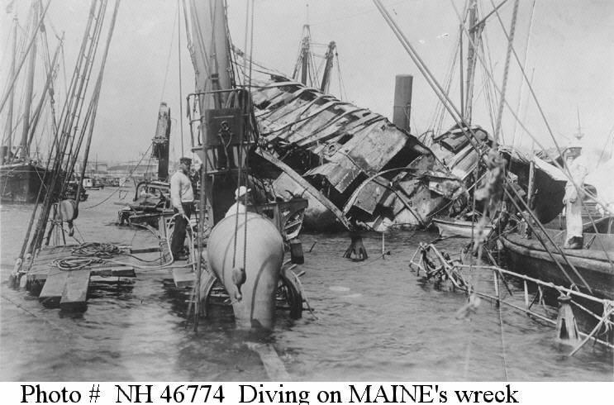

Slide 34
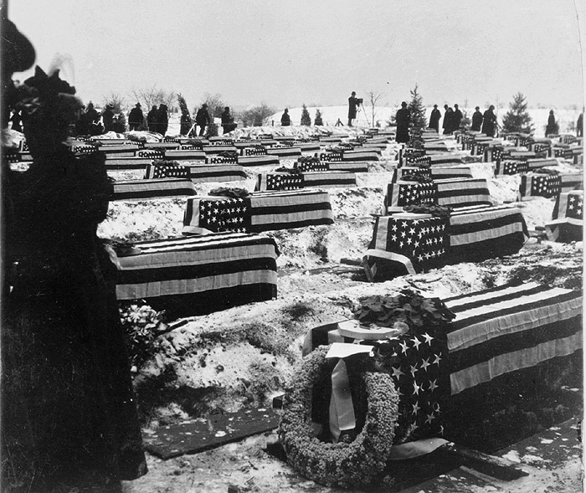

Slide 35
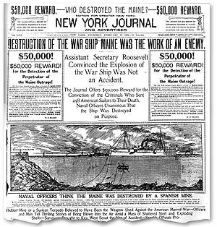
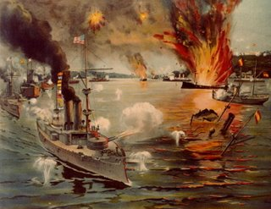
The Effects of Yellow Journalism
On February 15, 1898 the Maine mysteriously blew up and the US blamed a Spanish mine. When the American public was stirred into an anti-Spain frenzy by the yellow journalism of men like Hearst and Pulitzer, President McKinley gave the OK for war.

Slide 36
McKinley Declares War
McKinley’s first move against the Spanish is against its naval forces, hoping to cripple Spain’s ability to wage war against the US.
A major portion of Spain’s naval forces were in its Philippine colony.
Weeks prior to declaring war, McKinley had been planning for this eventuality. Admiral Dewey had been stationed to the north in Hong Kong.

Slide 37
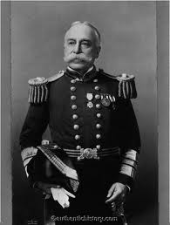
Admiral Dewey

Slide 38
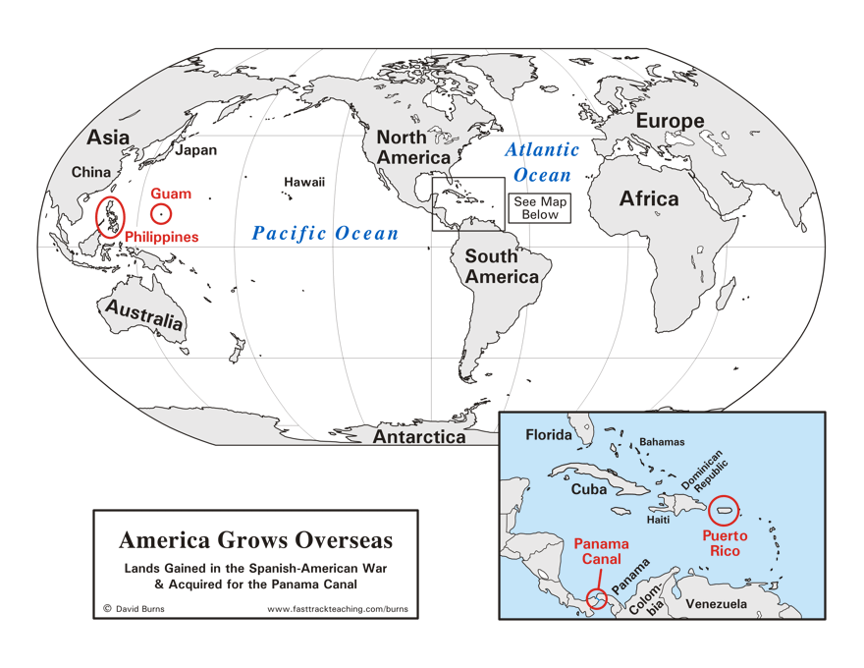

Slide 39
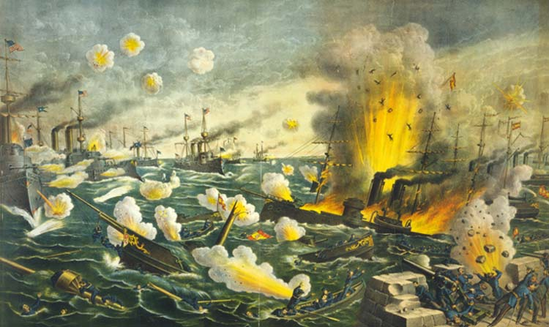

Slide 40
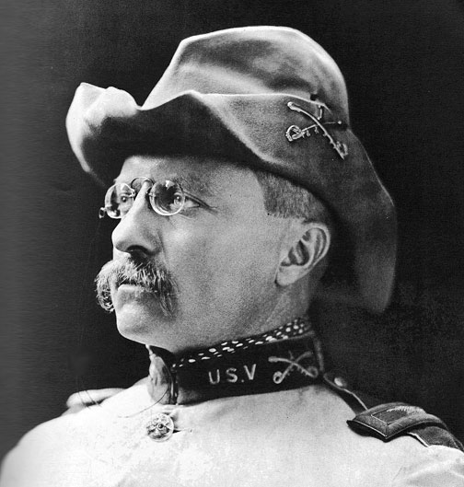
Theodore Roosevelt

Slide 41
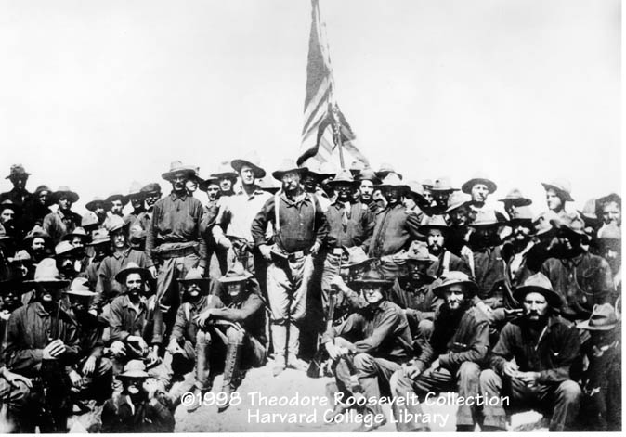
Roosevelt’s “Rough Riders”

Slide 42
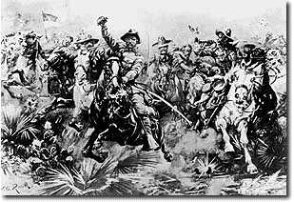

Slide 43
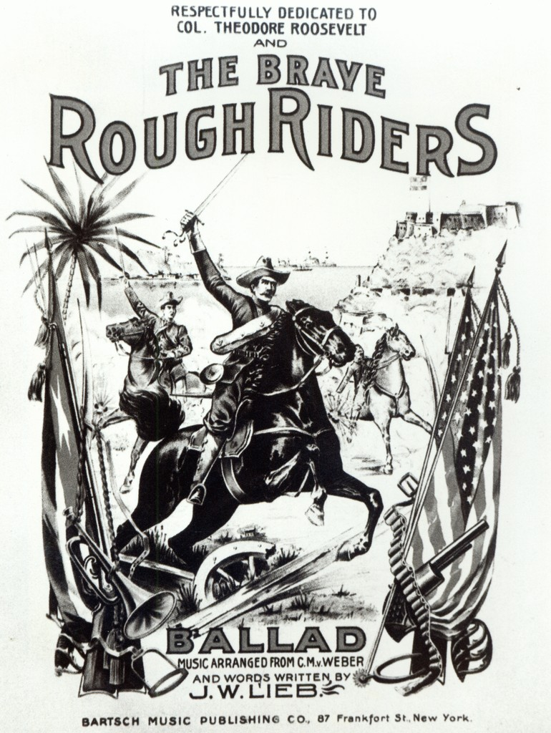

Slide 44
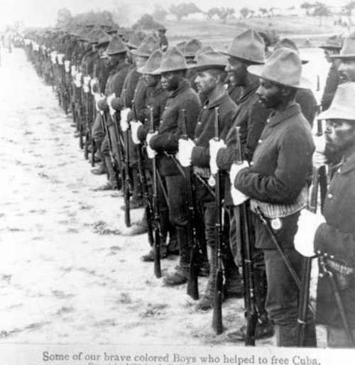
Buffalo Soldiers

Slide 45
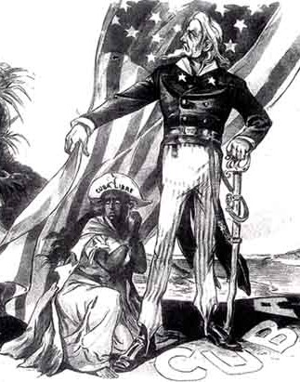
Teller Amendment
Congress agreed, but only after adopting the Teller Amendment that made it clear that the United States did not harbor imperialist ambitions and would not acquire Cuba.

Slide 46
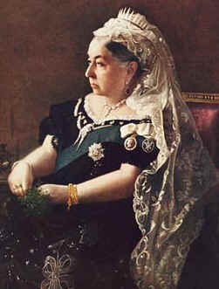
Shocked by Anti-Imperialism
European leaders were shocked by this declaration. Britain's Queen Victoria called on the European power to “unite... against such unheard [of] conduct."

Slide 47
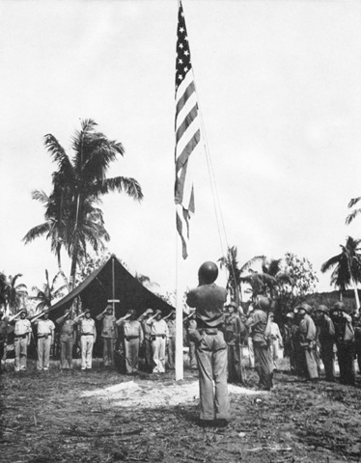
The Platt Amendment
After the US defeated Spain, it passed the Platt Amendment which gave the US the right to intervene in Cuba to protect "life, property, and individual liberties." The 144-day war also resulted in the US taking control of the Philippines, Puerto Rico, and Guam.

Slide 48
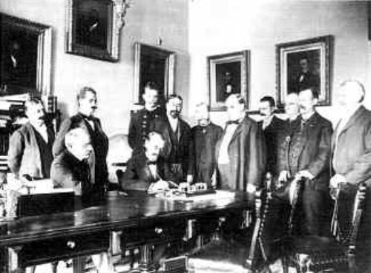
The Philippine American War
As a result of the Philippine American War, a sequel to the Spanish American War, Spain ceded the Philippines to the United States for $20 million. In response to being sold to the Americans, the people of the Philippines waged a guerilla war for independence against the American forces… the US military responded with extreme measures aimed at crushing any resistance to US authority.

Slide 49
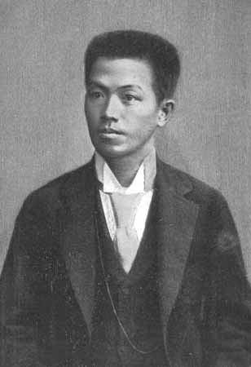
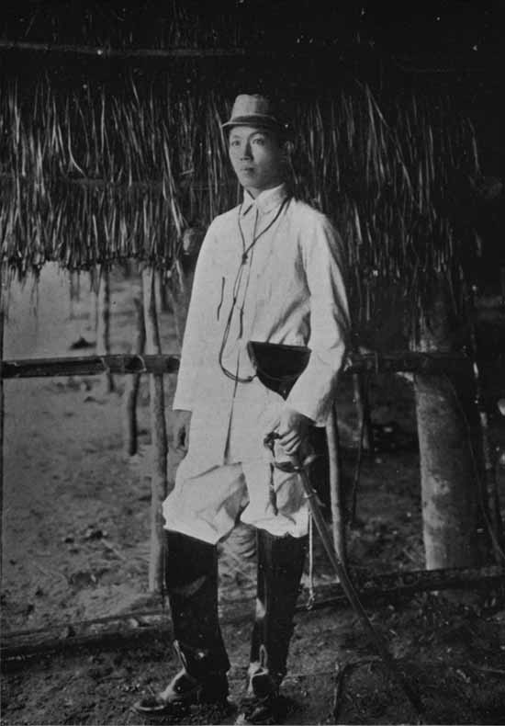
Emiliano Aguinaldo

Slide 50
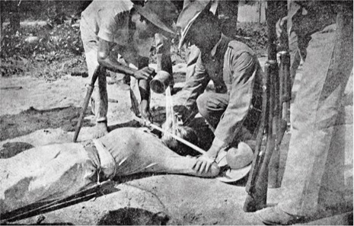
American Atrocities
To suppress Filipino insurgency, the American military forcibly relocated or burned villages, imprisoned or killed non-combatant civilians, and used vicious torture techniques (including the water cure) on suspected insurgents.

Slide 51
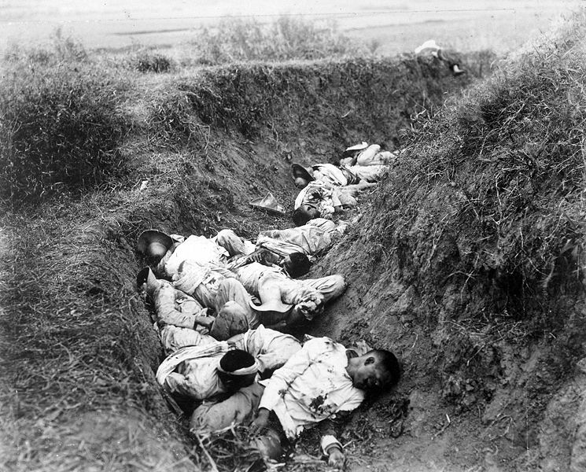

Slide 52
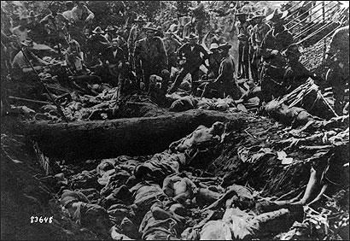

Slide 53
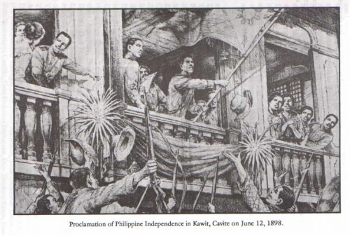
Philippine Independence
During the war, more than 4,000 American soldiers, about 20,000 Filipino fighters, and an estimated 200,000 Filipino civilians died. After a long struggle, the Filipinos received their independence in 1946.

Slide 54
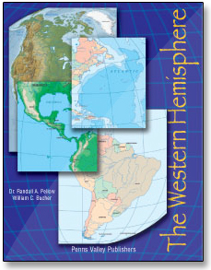
Interventions in Western Hemisphere
To enforce order, forestall foreign intervention, and protect economic interests, the United States intervened in the Caribbean and Central America some twenty times over the next quarter century -- in Cuba, the Dominican Republic, Haiti, Mexico, Nicaragua, and Panama.

Slide 55
The Banana Republics
The combination of factors; fear of foreign competition and growing dependency on foreign trade especially, prompted the US to reassert its long-standing foreign policy… the Monroe Doctrine. Particularly with respect to the Caribbean.

Slide 56
The Roosevelt Corollary
In 1904, when Germany demanded a port in the Dominican Republic as compensation for an unpaid loan, Theodore Roosevelt announced the Roosevelt Corollary to the Monroe
Doctrine, declaring that the United States would be the policeman of the Caribbean and Central America.

Slide 57
Protection of American Interests
On the whole, the United States’ actions in Latin America protected US commercial and strategic interests, but the goal of spreading democracy went mostly unfulfilled. The frequent use of military force also engendered widespread resentment in the region.

Slide 58
American Influence in China
Soon after defeating the Spanish in the Western hemisphere and gaining their territories, the US set its sites on securing key trade markets in Asia… most notably, China!
Many European countries had vital trade interests in that region and were struggling among themselves to secure the market.

Slide 59
Open Door Policy
McKinley’s Secretary of State, John Hay, wrote notes to the major European powers suggesting they all “keep an open door to China” (in other words, they’d share the market evenly)… the Europeans weren’t very impressed with the idea.

Slide 60
Sec. of State John Hay

Slide 61
The “Boxer Rebellion”
All this fighting over control of the Chinese market didn’t sit too well with the Chinese… who, by this point, were angry about all the foreign influence upsetting their society, culture, and government.
A secret society formed calling themselves the “Righteous and Harmonious Fists” … western press called them “Boxers” The Boxers began an armed rebellion against western interests. The European and Americans resisted with great force, ending what came to be known as “The Boxer Rebellion”

