Slide 1
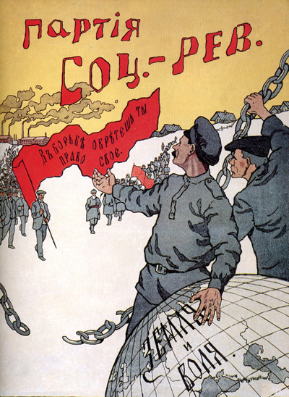
The Russian Revolution

Slide 2
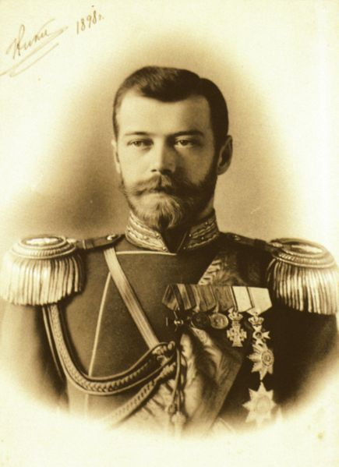
Tsar Nicholas II
Last Royal Emperor of Russia.
Nicholas was the last of the Romanov Dynasty. The longstanding economic
Issues in Russia combined with the onset
of WWI doomed the Monarchy to Revolution within Russia

Slide 3
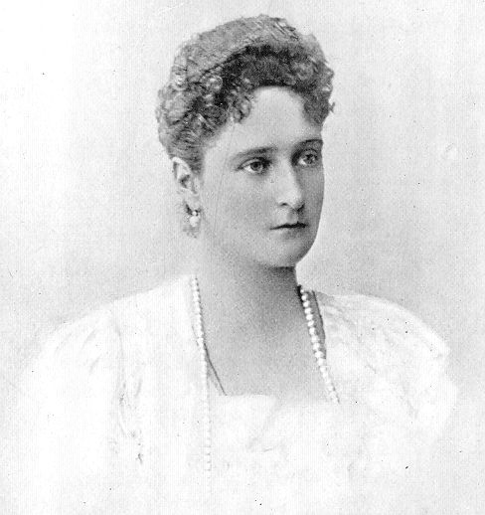
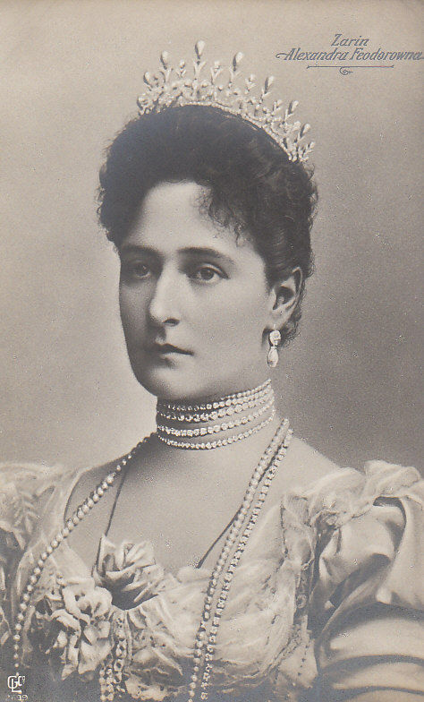
Czarina Alexandra

Slide 4
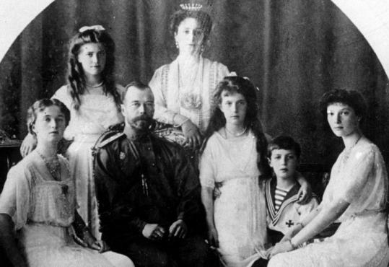
The Royal Family

Slide 5
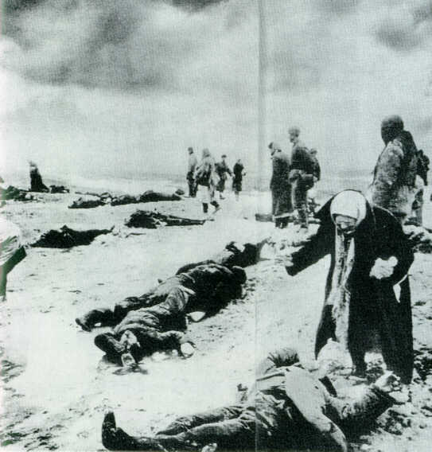
WWI Impacts Russia
Family members in
Russia collect the bodies of their relatives on a frozen battlefield.
The Russian people
endured famine and
disease compounding
the suffering of WWI

Slide 6
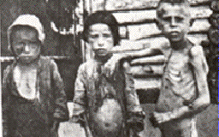

Slide 7
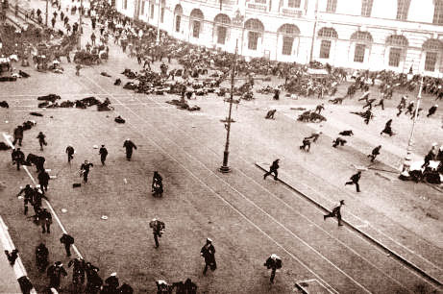

Slide 8
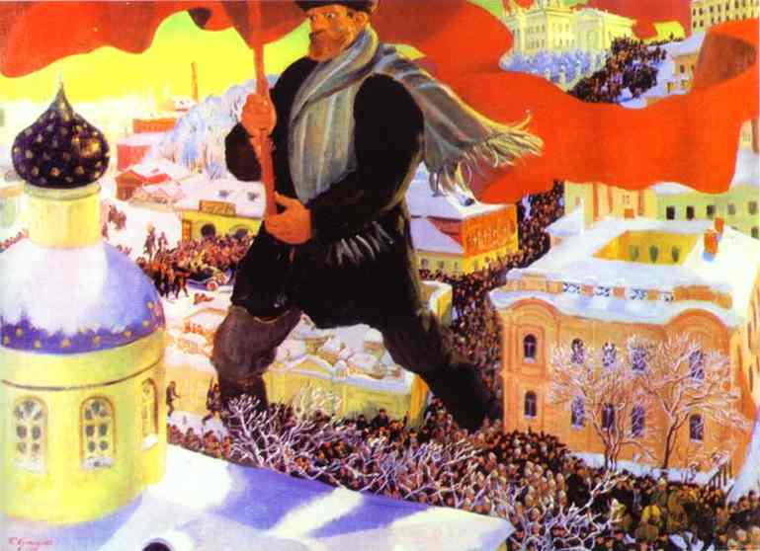
Painting depicting the Bolshevik Revolution in Russia

Slide 9
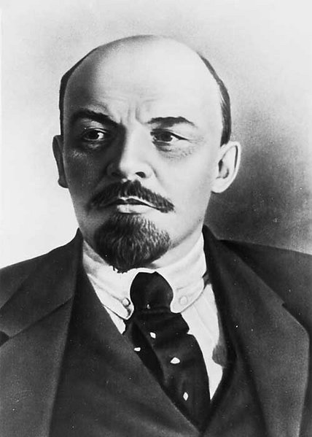
Vladmir Lenin
Founder and Leader of the
Bolshevik Party and the
world’s first Socialist
revolution; the Russian Revolution 1917
He will become the first leader of the new
Soviet Union

Slide 10
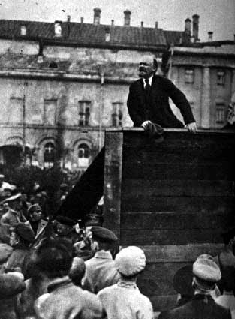
Lenin giving a speech at a
Bolshevik political rally.

Slide 11
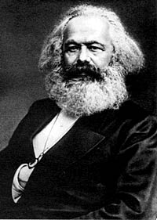
Karl Marx
Economic Philosopher
Co-wrote the Communist
Manifesto which outlined
his predictions of future
world affairs that included the concept of a
world socialist revolution
His ideas will change
the world.

Slide 12
Karl’s Prediction
People will realize that Capitalism is a broken, evil system: Few have all the wealth, and all the rest are dependent on the few wealthy.
Workers will rise up and seize the wealth and create a central system to guarantee equal sharing of everything.
After an undetermined time period, people will no longer need the central system and will automatically share… no more need for government, or law, or money… COMMUNISM
This Prediction is the core of the Communist Manifesto, written by Marx

Slide 13
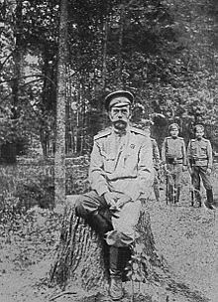
As the casualties of war grow and the Empire struggles to put down the rioting in the streets, the Czar tried to calm the people by personally overseeing the war at the German front.

Slide 14
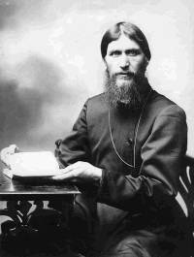
Rasputin
Grigori Rasputin gained
influence as a ‘mystic’ or
psychic and faith healer.
When the war began to
threaten Nicholas’ reign, the
Tsar took complete control
over the military and put his
wife in control of the
government.
Alexandra made Rasputin
her top advisor further
increasing the people’s
distrust of the Royal Family.

Slide 15
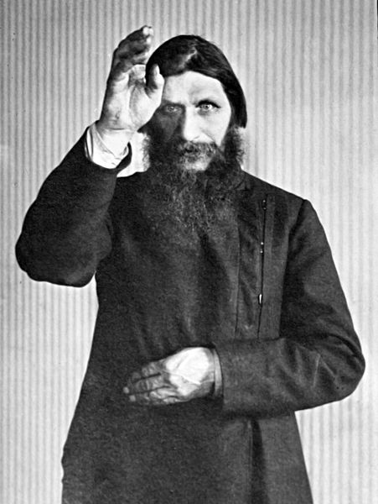

Slide 16
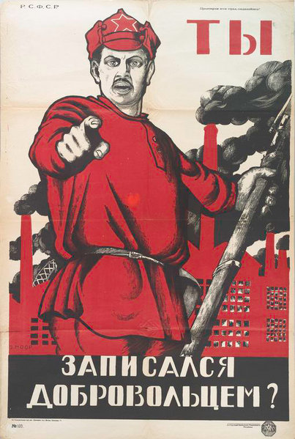
Russian Civil War
In March of 1917 Tzar
Nicholas abdicates (gives
up) his throne due to his
inability to stabilize the
revolt and rioting of the
people. His own police and
troops refuse his orders.
A Provisional Government
is put in place but had no
real power.
Separate groups, including
the Bolsheviks, fight a Civil
War against the “White Army” for rule over Russia.
Red Army Recruitment Ad.

Slide 17
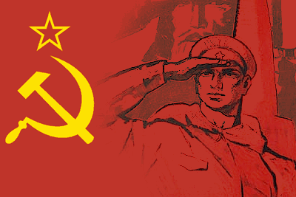
The Birth of the USSR

Slide 18
Impact of the Revolution on WWI
Russia, under the Bolsheviks, pull out of the war…
The NEED for the US to step in and STOP the Germans dramatically increases.
Socialist propaganda has an impact on American politics

