Slide 1
THE 20s

Slide 2
Rapid Social Change Post WWI
Women’s Rights
Demographic Shifts
Mass Media
Jazz Age

Slide 3
Women’s Rights
For decades (since the early 1800s) women and women’s groups have been working on gaining equal political, economic, and social rights.
The signing into law of the 19th Amendment in 1919 provided great energy for the women’s rights movement prompting women to assert themselves in education, the workforce, politics and to challenge traditional social rules.

Slide 4
Flappers
In the 1920s, a new woman was born. She smoked, drank, danced, and voted. She cut her hair, wore make-up, was giddy and took risks. She was a flapper.
"I had no idea of originating an American flapper when I first began to write. I simply took girls whom I knew very well and, because they interested me as unique human beings, I used them for my heroines.“ - F. Scott Fitzgerald

Slide 6
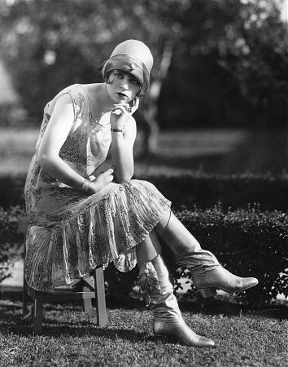

Slide 7
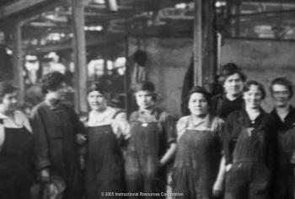

Slide 8
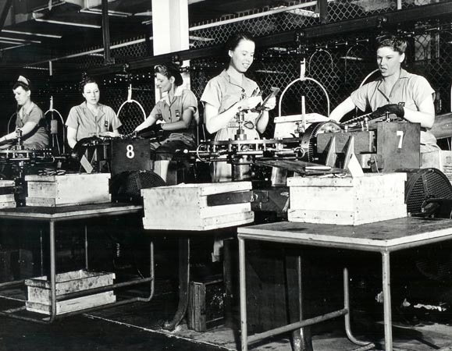

Slide 9
Demographic Shifts
Rural to Urban Shift (Newly middle-class)
Urban to Suburban Shift (wealthy)
The “Great Migration”: African American Farmers Move to Northern Industrial Cities (new labor opportunities, escape jim crow)

Slide 10
Rural to Urban Shift
After the war, there was a MAJOR pent-up demand for products of all varieties as well as new products hitting the market… this led to RAPID INDUSTRIALIZATION. Many new factories sprang up around cities all over the nation. Rural residents left the countryside seeking a new life in the city
For the first time in our history, there were more Americans living in cities than in the country.

Slide 11
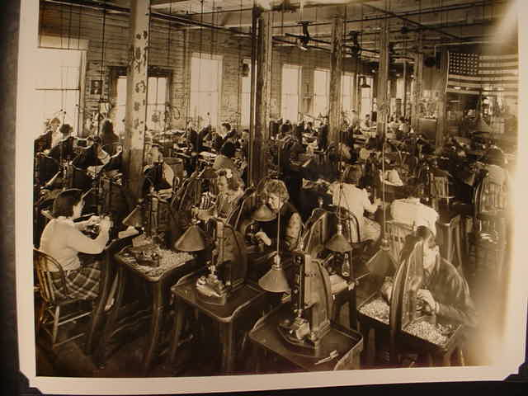

Slide 12
Urban to Suburban Shift
Cities rapidly became over-crowded and dirty. The opportunity to work in the city but live just outside of the noise and congestion came with the AUTOMOBILE.
Cars became affordable with MASS PRODUCTION.
SUBURBS develop and occupied by those who could afford a car and the move… white middle-class and upper class.

Slide 13
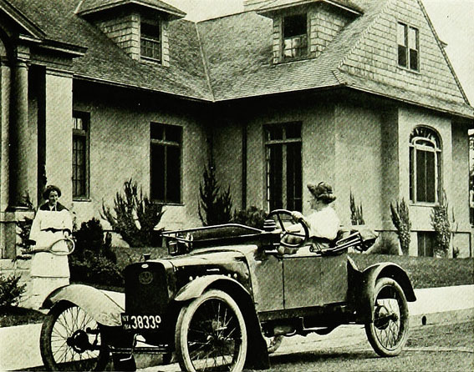

Slide 14
The “Great Migration”
Sharecropping in the Jim Crow South was a difficult, misserable existence for most of the African American population there. The rapid industrial development in Northern cities created demand for labor… seizing upon the opportunity to escape the conditions in the South, millions of southern black families headed North. This demographic shift in America’s history is called the “Great Migration”

Slide 15
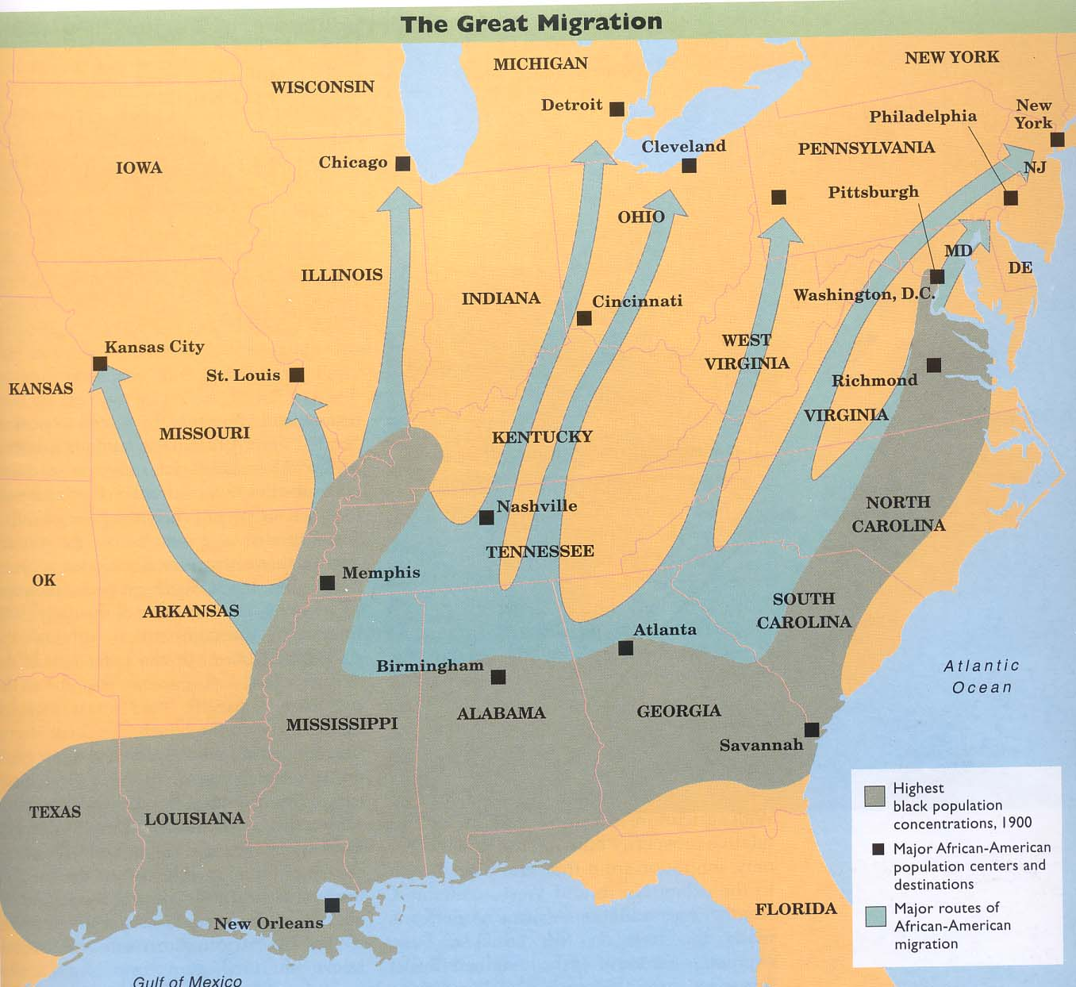

Slide 16
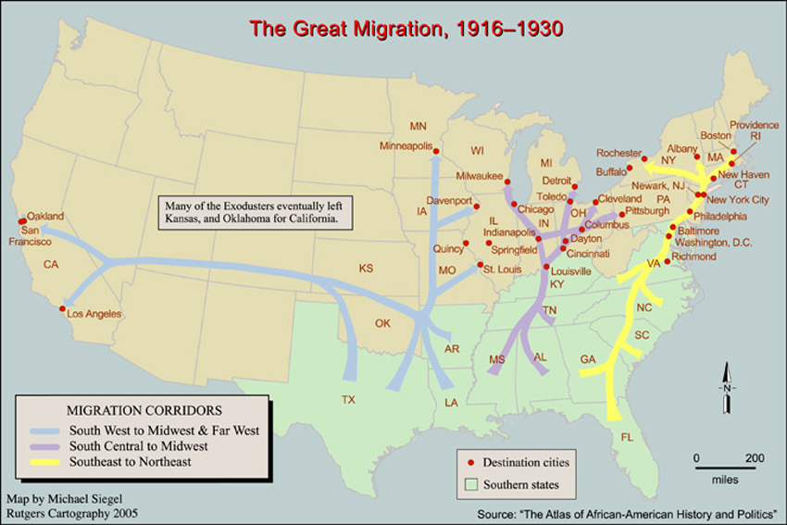

Slide 17
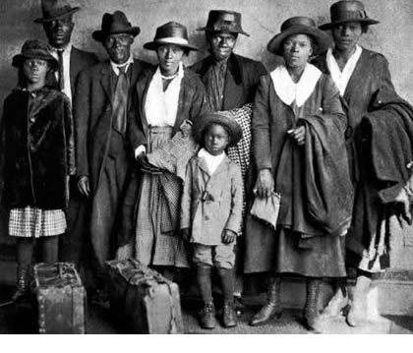

Slide 18
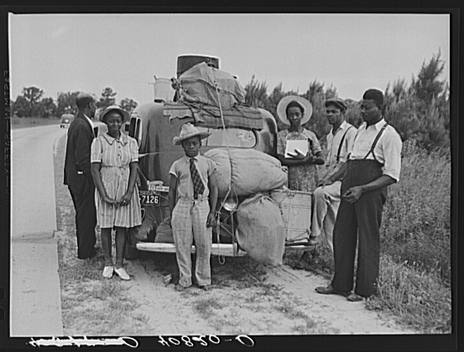

Slide 19
