Slide 1
Key Battles for Victory against the Germans
Natalie, Slade, Kenyon, Jude, Brittni, Wes, Matt

Slide 2
The Battles of the Marne
First Battle of the Marne: (The Battle of Chateau-thierry)
Gen. Pershing dispatched troops to turn back the Germans
A week later the Marine corps stopped Germans from attacking Belleasu and Chateau-thierry
When they marched out of Paris Gen. James G, Harbor told the men ”We dig no trenches to hold back on”
The Marines did exactly that and we lost over half of our troops.
Saved Paris, stopped the onslaught of the Germans, and turn the war

Slide 3
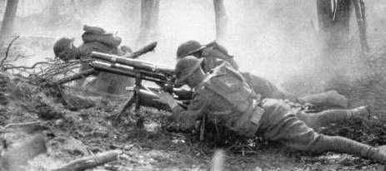
The Battles of the Marne
The Second Battle of the Marne
French forces were joined by 28,000 American troops
Forced Germans back into the river and into retreat.
Ended all hopes for a German victory.

Slide 4
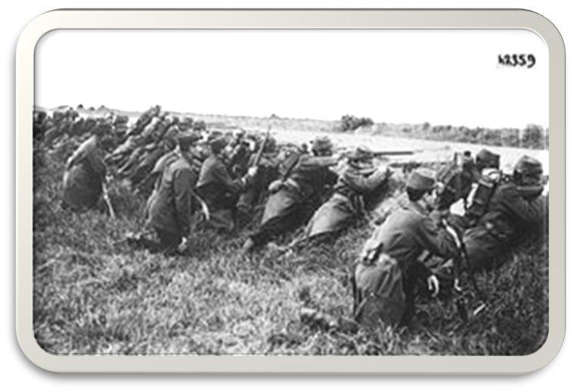
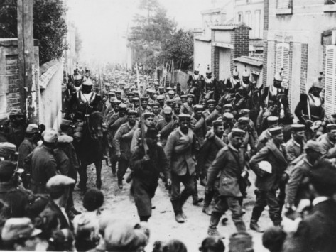
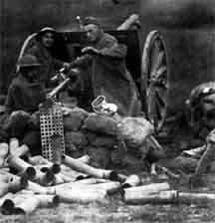
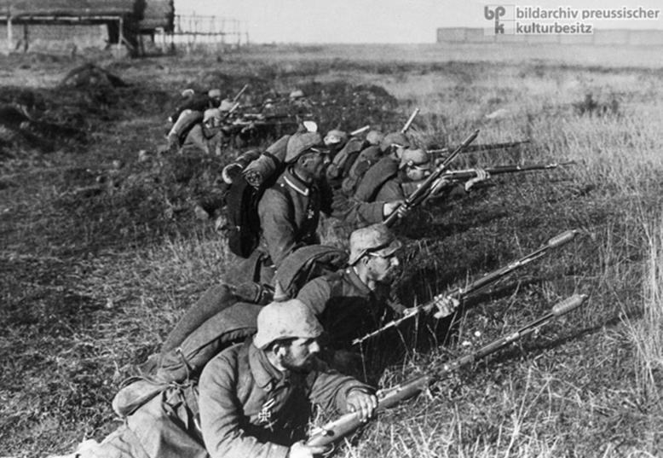

Slide 5
Battle of Amiens
The US broke the German lines using tanks
The Allied armies stopped the German advance in the north
The Allies re-captured German gains from earlier in the war

Slide 6
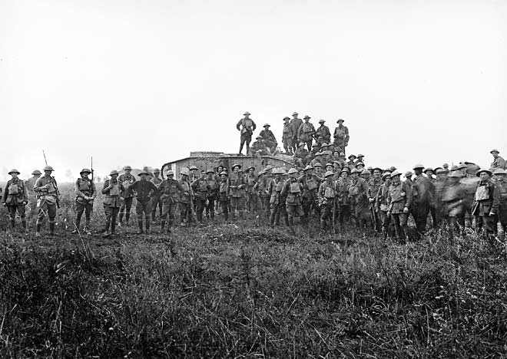
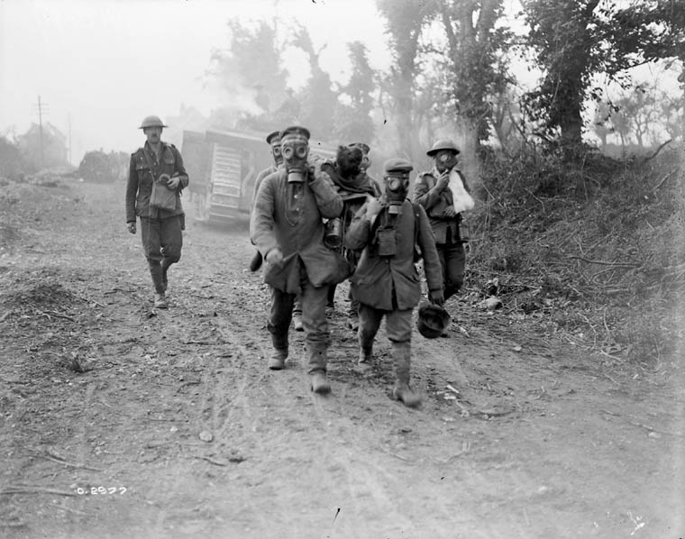
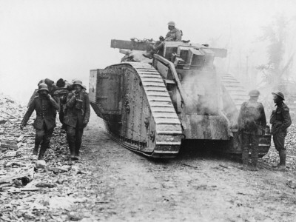

Slide 7
Meuse-Argonne Offensive
The final Allied assault, began on September 26th of 1918
Over a million AEF troops drove Germany from France
This cut Germany’s supply lines,
Caused Germany to retreat from the Argonne forest and the Meuse river.

Slide 8
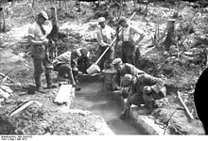
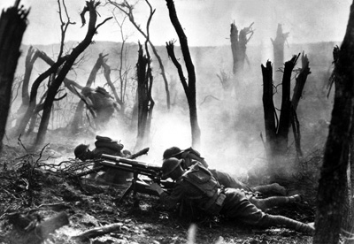
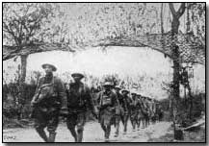

Slide 9
Armistice
A cease-fire
Was signed on November 11th, 1918 on a French railroad cart
6 hours later the guns fell silent
It ended the War

