Slide 1
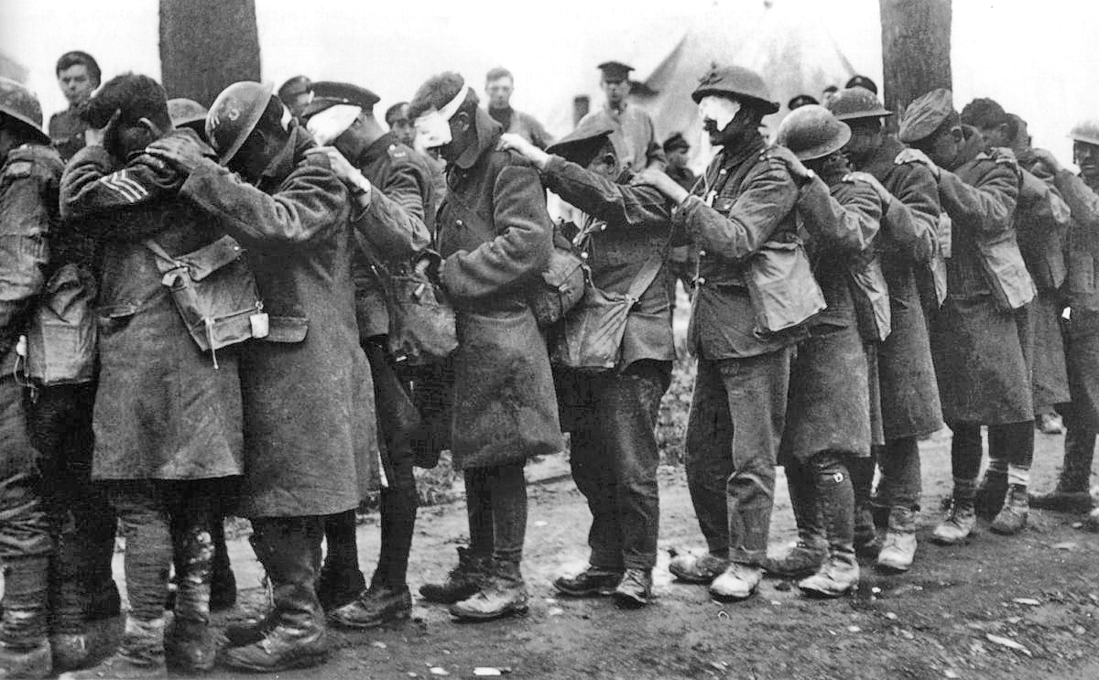
How WWI Ended
… and how that ending shaped the future right down to the present

Slide 2
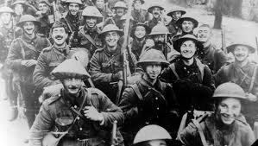

Slide 3
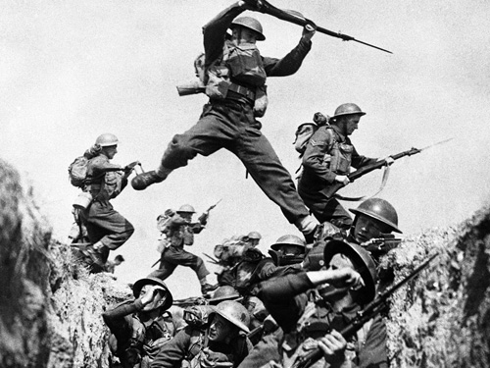

Slide 4
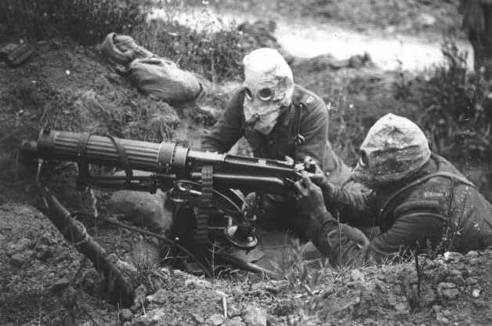

Slide 5
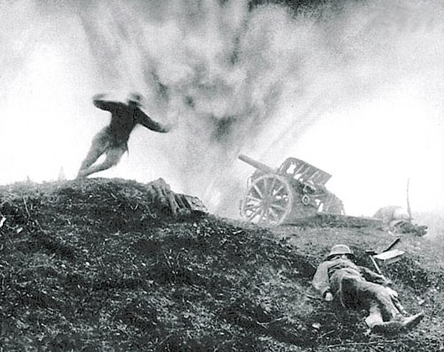

Slide 6
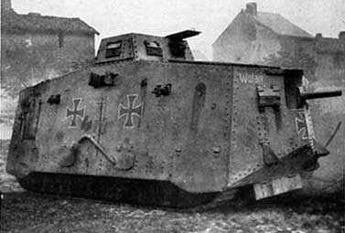

Slide 7
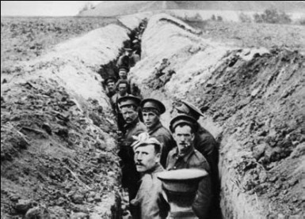

Slide 8
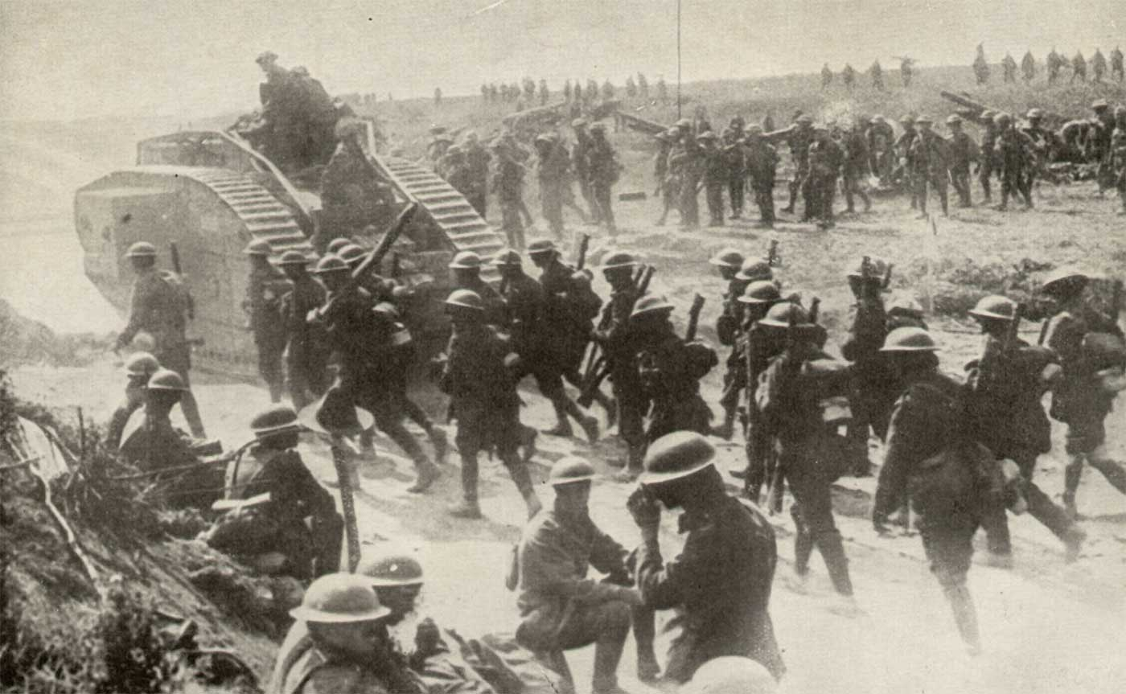

Slide 9
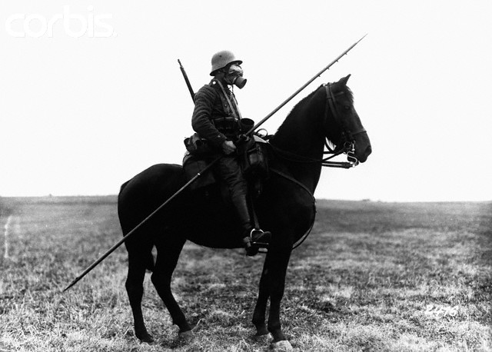

Slide 10
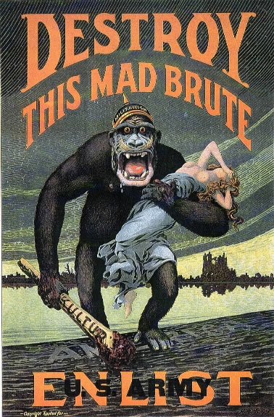

Slide 11
Results of WWI:
Russians were fighting both a war AND a revolution… MANY died at the hands of the technologically superior German Army
France: sooo many French were killed and maimed by the German invasion.
Britain: they too suffered great casualties
US: had we not shown up when we did the axis powers would have won and world history would be VERY different.
A-H: near collapse at war’s end
Ottoman Empire: near collapse at war’s end
Europe: ripped to pieces. Families, economies, governments… all destroyed in the war… a competition arises between monarchy, democracy, and a new popular idea called communism which promises everybody an equal share in everything.

Slide 12
The End of the War: Treaty of Versailles
Signed on June 28th 1919 as an end to the First World War, The Treaty of Versailles was supposed to ensure a lasting peace by punishing Germany and setting up a League of Nations to solve diplomatic problems. Instead it left a legacy of political and geographical difficulties which have often been blamed, sometimes solely, for starting the Second World War.

Slide 15
The Treaty of Versailles
Developed by the “Big Three” Britain, France, US
Each wanted something different:
US wanted security/peace: 14 Points (Wilson)
France wanted revenge on Germany
Britain wanted what US wanted but sided with France due to public outcry for revenge

Slide 16
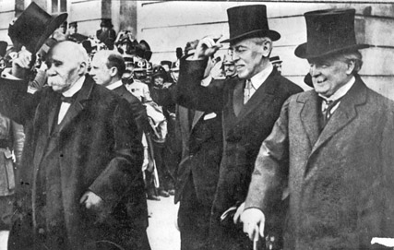
PM Lloyd George Pres Wilson PM Clemenceau

Slide 17
The 14 Points
14 Ideas to help eliminate the potential for another disastrous world war among the great industrial nations.
Woodrow Wilson will be the first American President to leave the western hemisphere or visit Europe. He was greeted by throngs of excited crowds who gave him a hero’s welcome.

Slide 18
Wilson’s 14 Points
Woodrow Wilson brought with him a “blueprint” for World peace… the 14 Points:
League of Nations
Self Determination
No more alliances
The idea of Self Determination excited the colonized regions of the world… statehood seemed within reach for them. They were about to find out that self determination wasn’t intended for non-European peoples

Slide 19
What Was In The Treaty:
Germany:
Forced to take blame for the war
Loses territory (nearly half used to create Poland)
Loses military power
Loses monarchy: Weimar Republic installed
Reparations forced on them

Slide 20
Austria-Hungary
The Big Three divides the former empire along ethnic lines… giving rise to the more familiar Eastern Europe map you know today (for the most part)… Countries like Czechoslovakia, Romania, Hungary… are produced… they get statehood (self determination)

Slide 21
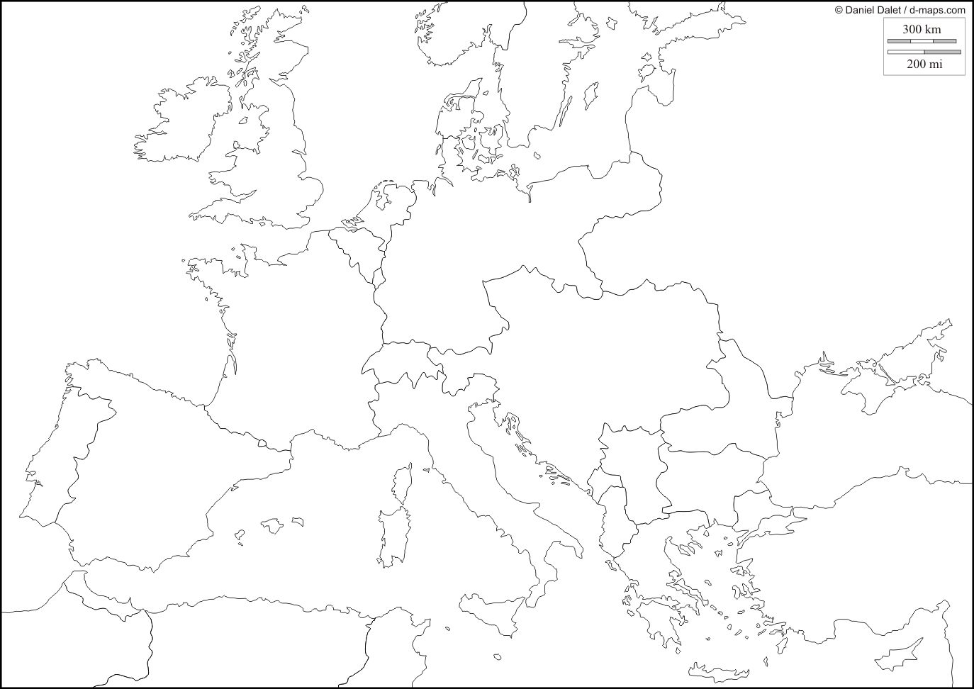

Slide 22
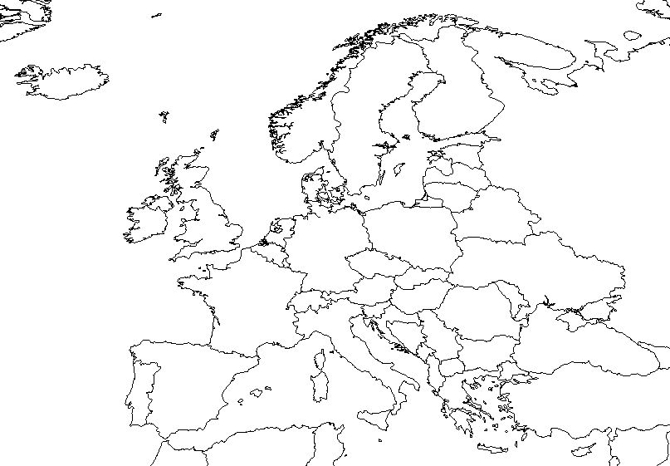

Slide 23
The Ottoman Empire
Here’s where the story gets really sticky… The Ottoman Empire was vast and multi-ethnic/ multinational. Many of these nations were hopeful that they too would finally experience independence like E. Europe… not so.
The former Ottoman Empire was divided between Britain and France for each to temporarily hold as a “Mandate” or temporary custody.
Why were the various ethnic groups of the Ottoman Empire not granted autonomy??
Greed
Racism
Politics

Slide 24
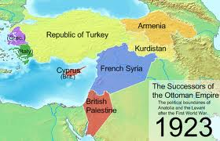

Slide 25
The British Mandate
Almost immediately, the Brits get out their map and a ruler and begin cutting up the region into more-easily governed parts. Places like Transjordan, Syria, Iraq, and Palestine are created without regard to ethnic, religious, or traditional boundaries already in existence.
They will soon find that their “more-easily governed” parts are a real mess. However, the Brits refuse to admit their mistakes and try to make it work anyway.

Slide 26
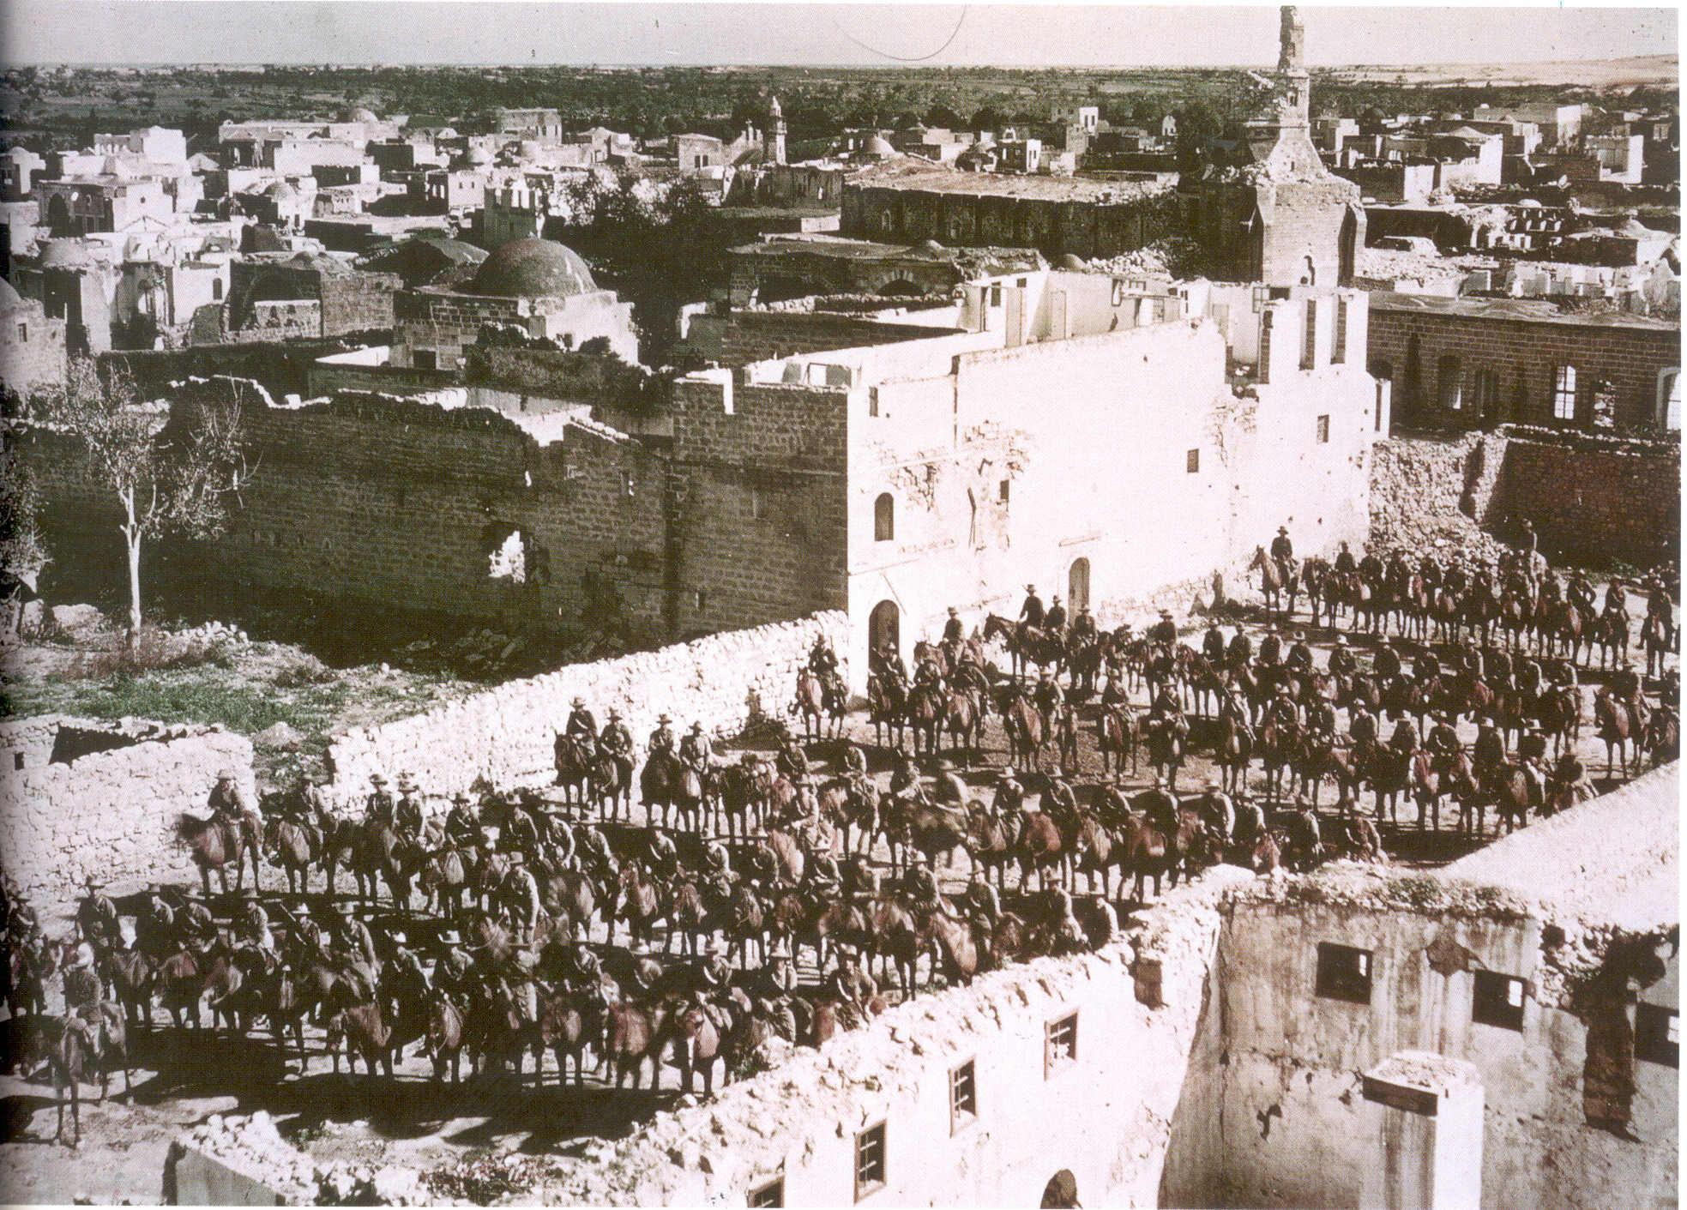

Slide 27
The British Mandate
Immediately after receiving their mandate, the British are approached by two ethnic groups seeking statehood:
Jews (found throughout Europe) Were political and military allies to the Brits during the war.
Palestinians (living in “Palestine”) Were promised statehood by the Brits in an earlier negotiation.
*The stage is set for one of the longest, bloodiest, territorial disputes of all time… one that has global consequences.
Begin Israeli-Palestinian video.

Slide 28
Colonial Outcry for Self-Determination
France’s holdings in Southeast Asia pay especially close attention to the negotiations in Versailles and were very excited about the prospect of self-determination and send their own representatives to plea for their own independence.
The ethnic Vietnamese have wanted independence from the French for a long time. Their leader, a man named Ho Chi Minh went to seek statehood.

Slide 29
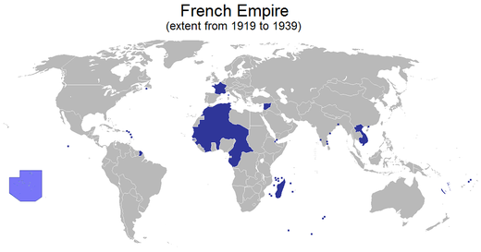

Slide 30
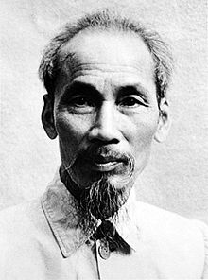

Slide 31
The League of Nations…
The League was formed and every key nation who was expected to play a key role joined… except one:
The United States
…even though the League of Nations was an American idea, the US Congress felt that joining would mean that America would give up too much of its own autonomy by participating. Without the US, the League failed to have the authority necessary to carry out its core purpose… to be a deterrence of conflict and promote global peace.

